Slide 1
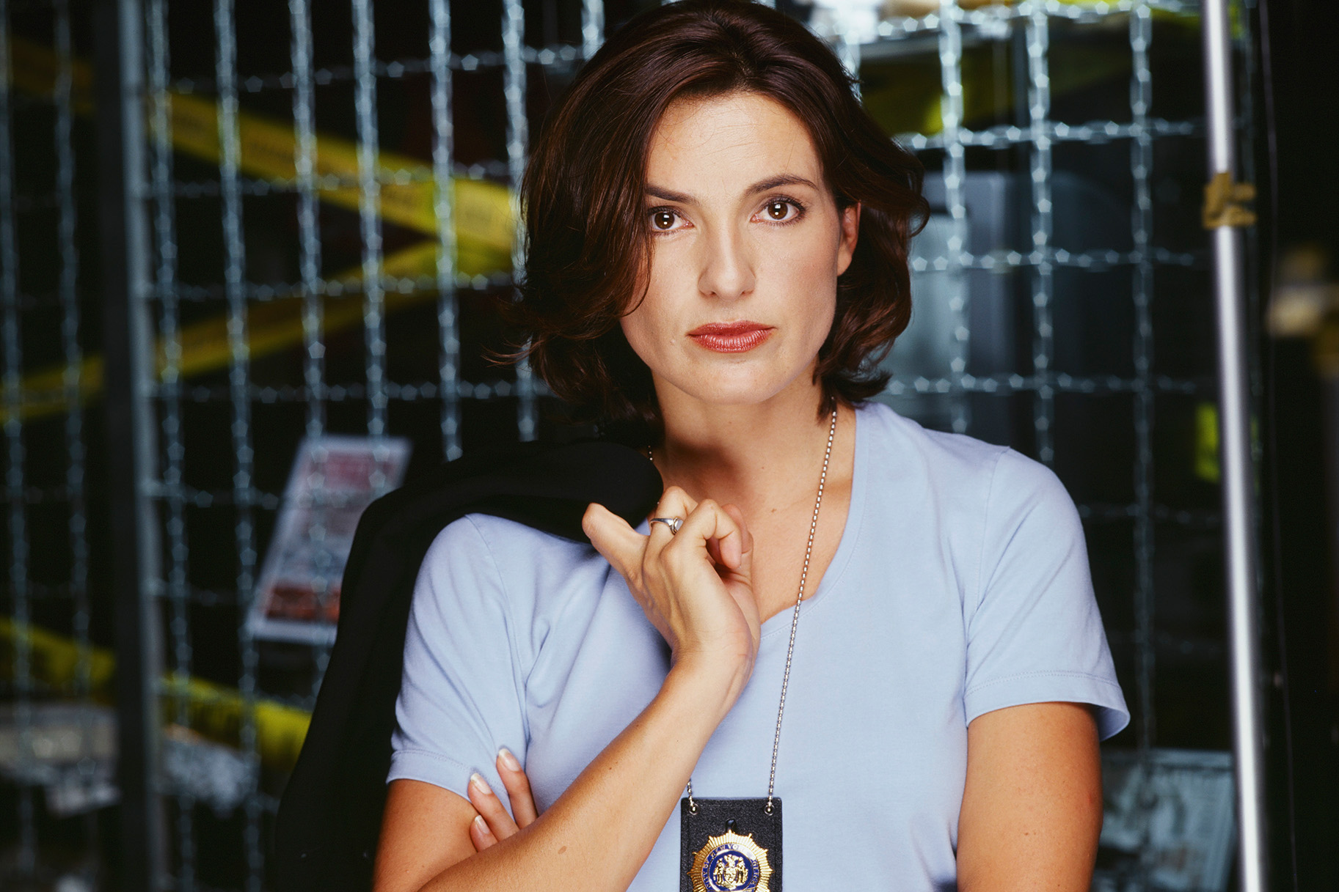
Notes:
Olivia Benson

Slide 2
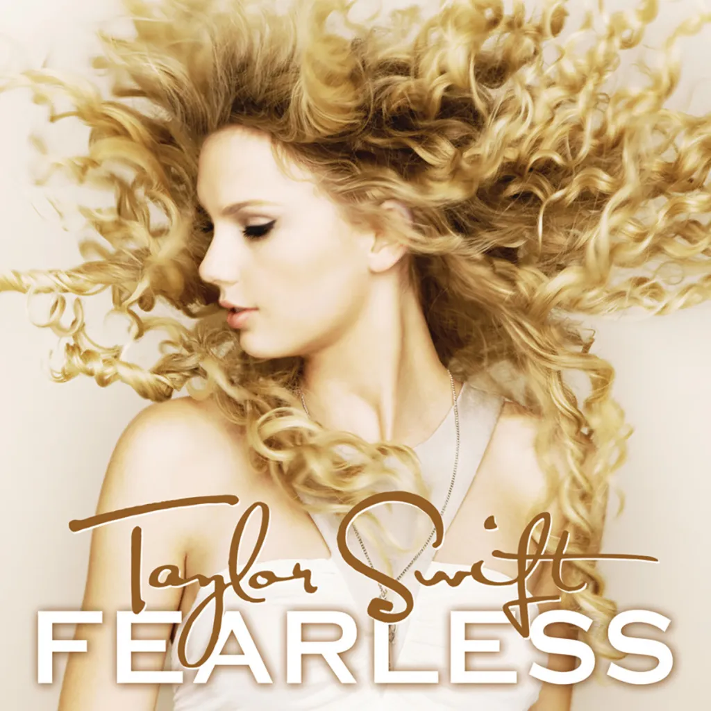
Notes:
Fearless

Slide 3
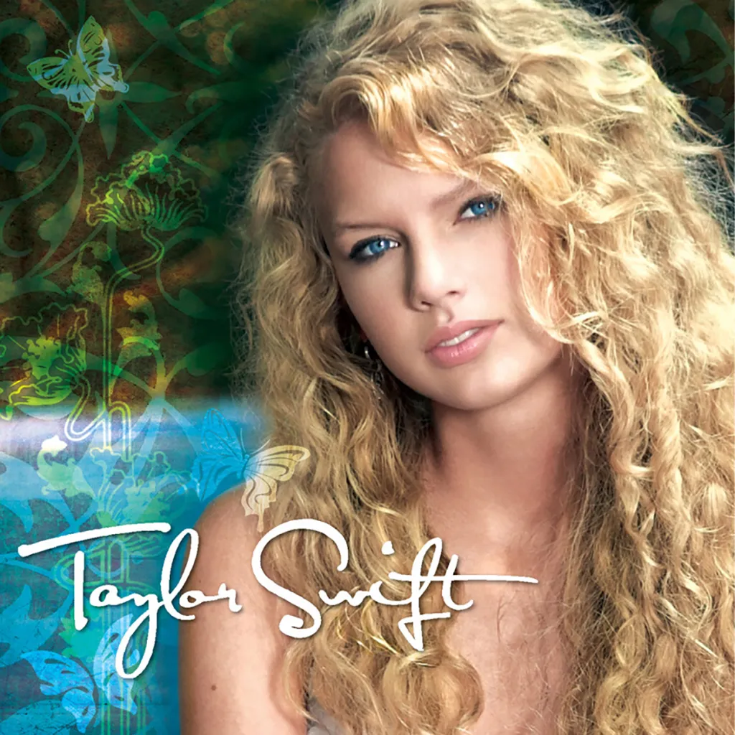
Notes:
Taylor Swift (Debut)

Slide 4
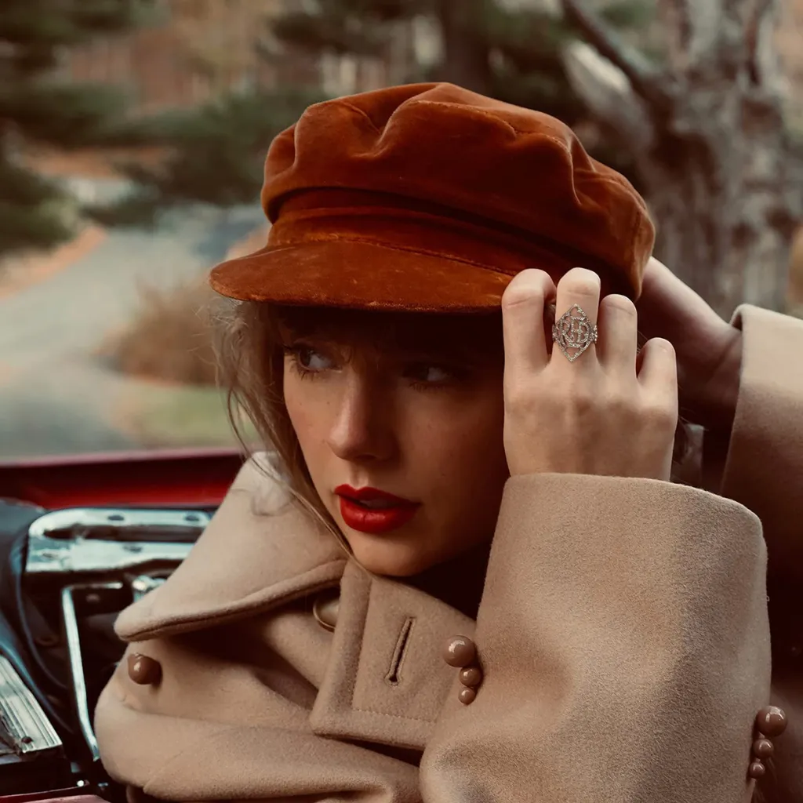
Notes:
Red (Taylor’s Version)

Slide 5
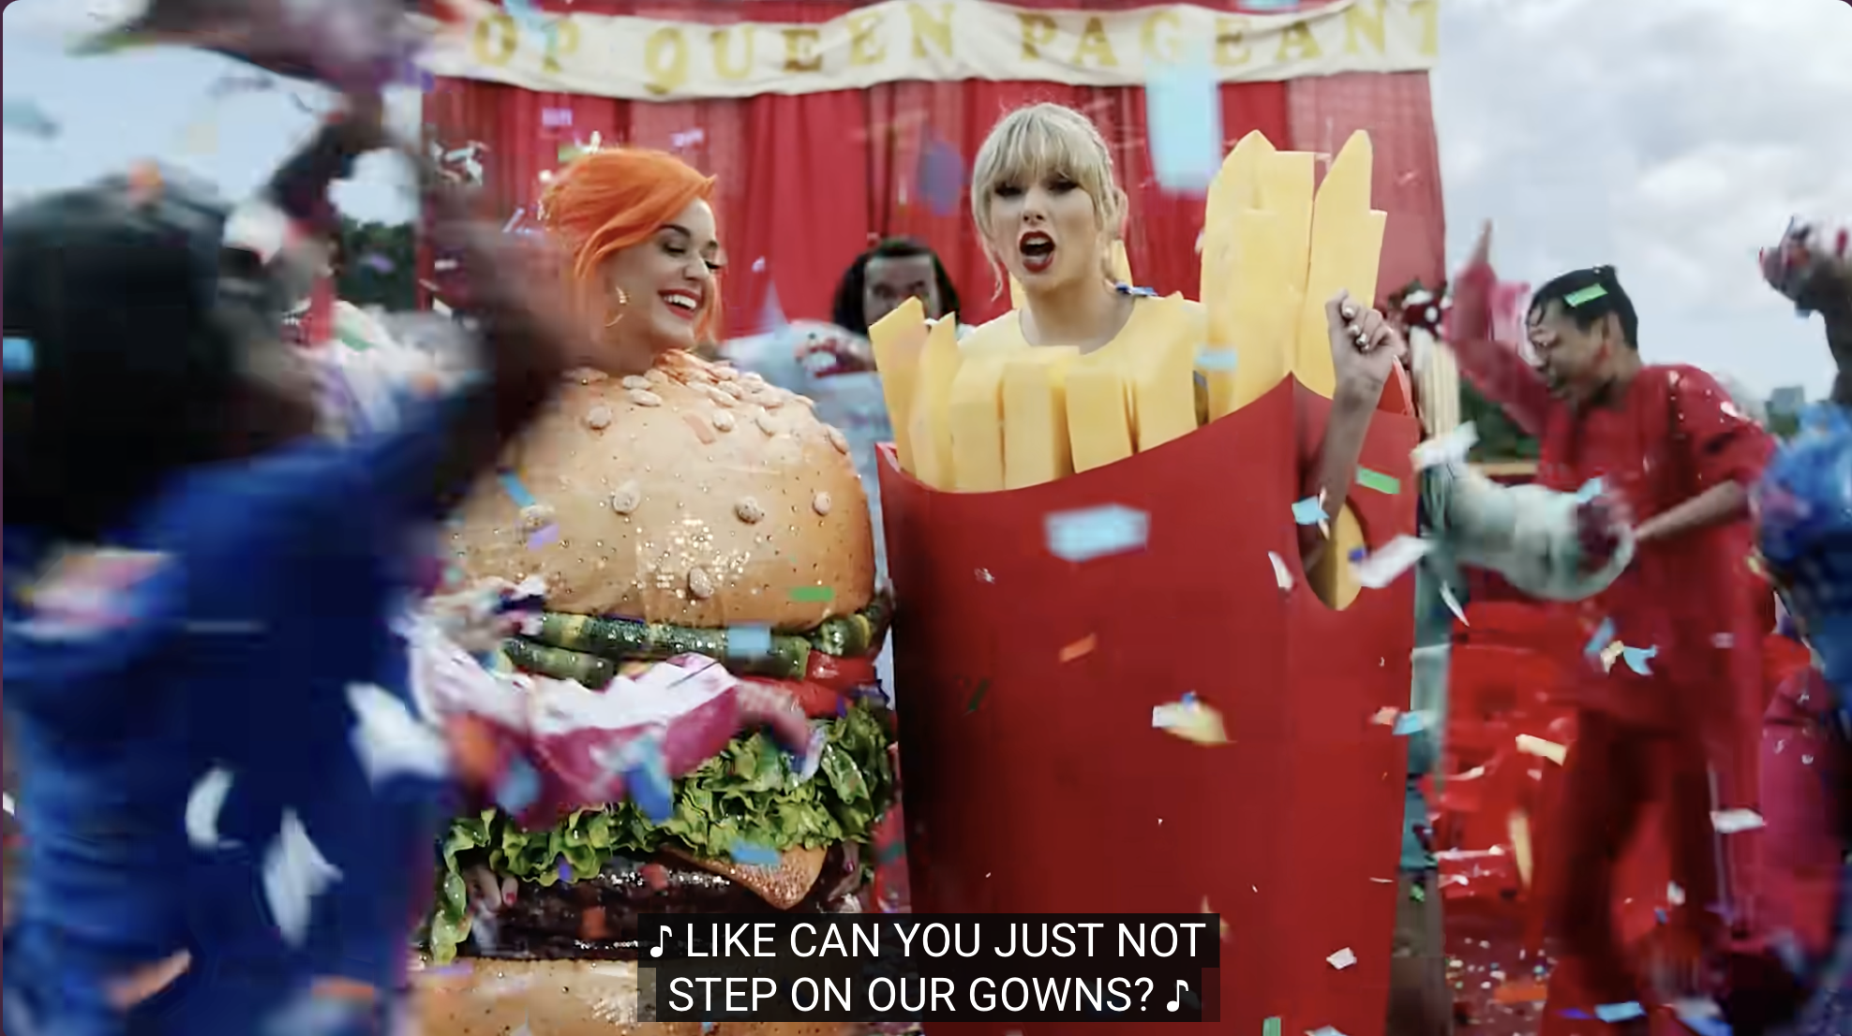
Notes:
You Need to Calm Down

Slide 6
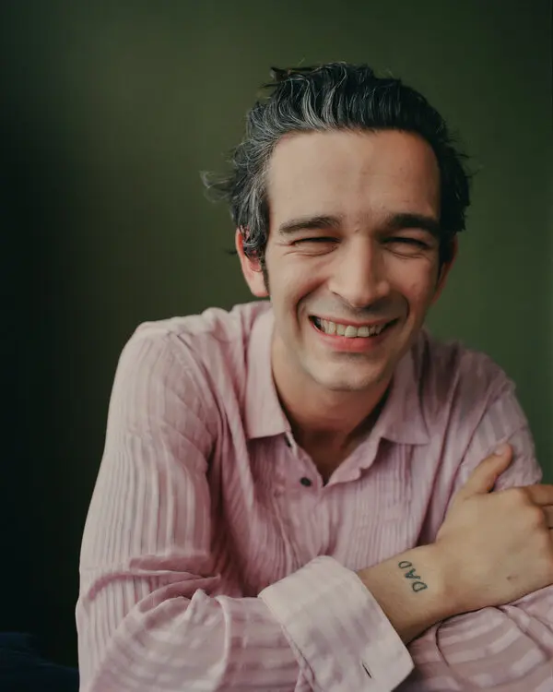
Notes:
Matty Healy

Slide 7

Notes:
Evermore

Slide 8
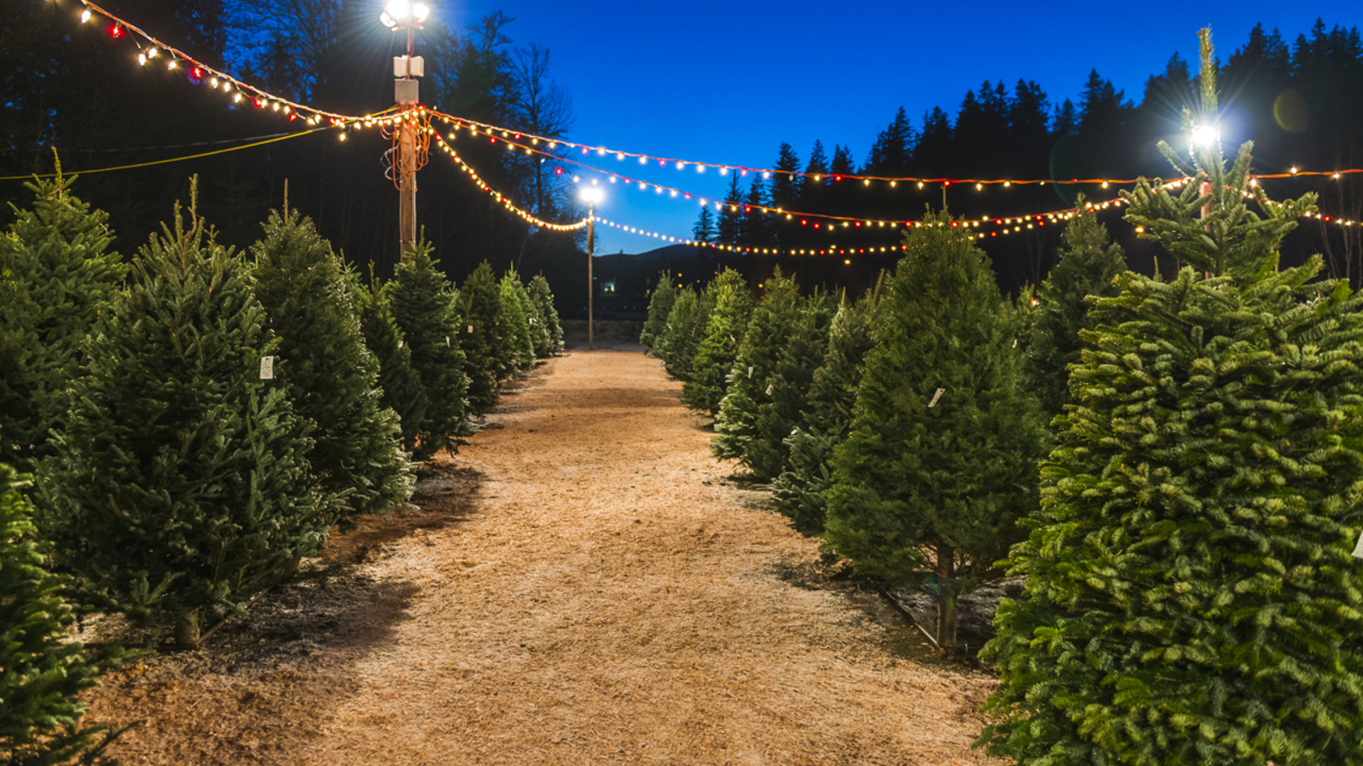
Notes:
Christmas Tree Farm

Slide 9
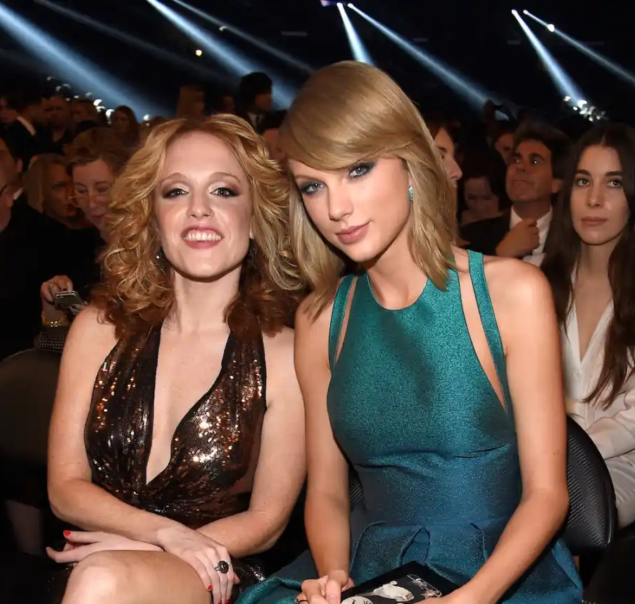
Notes:
Abigal Andersen

Slide 10
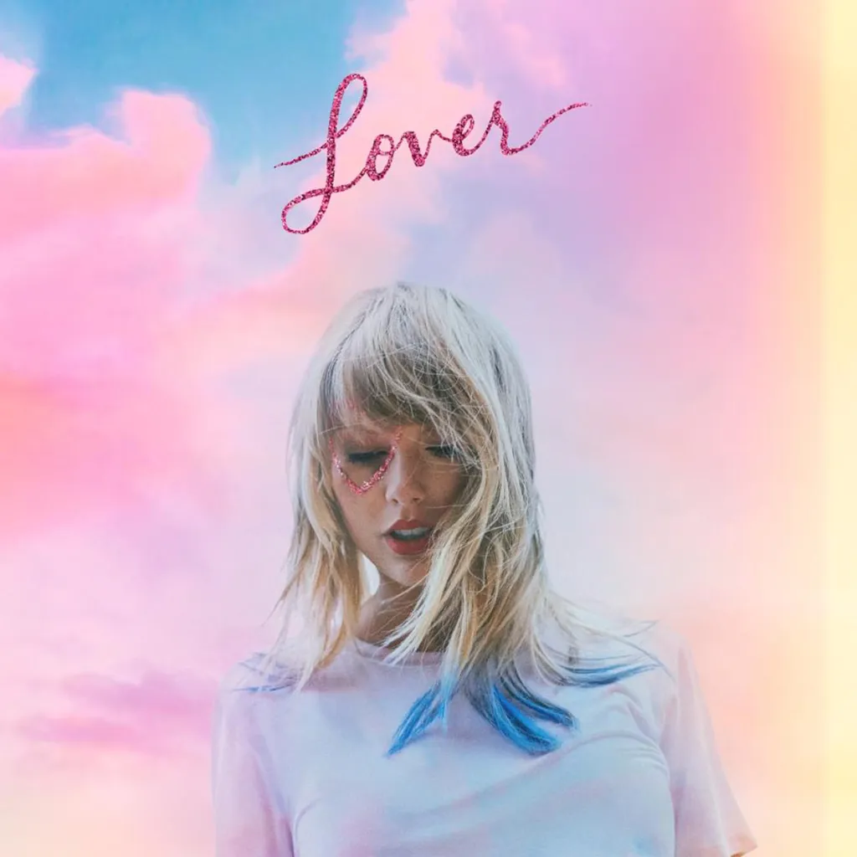
Notes:
Lover

Slide 11
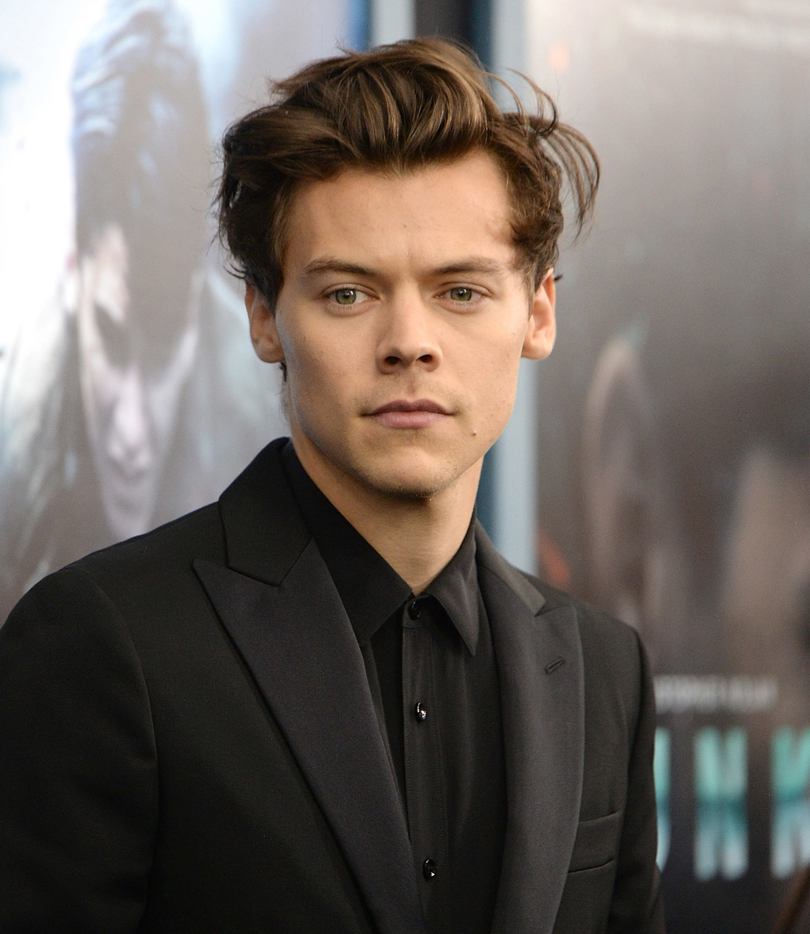
Notes:
Harry Styles

Slide 12
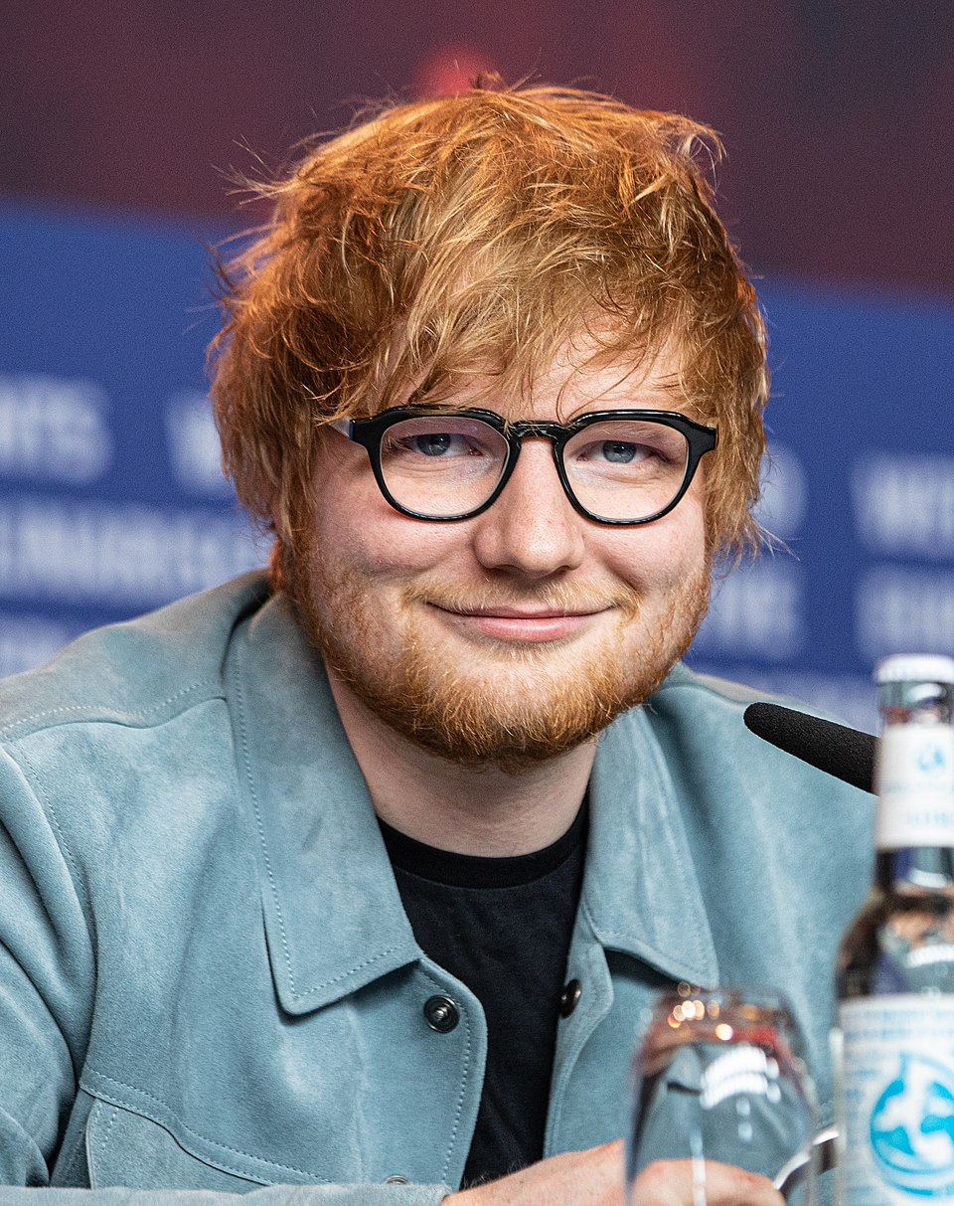
Notes:
Ed Sheeran

Slide 13
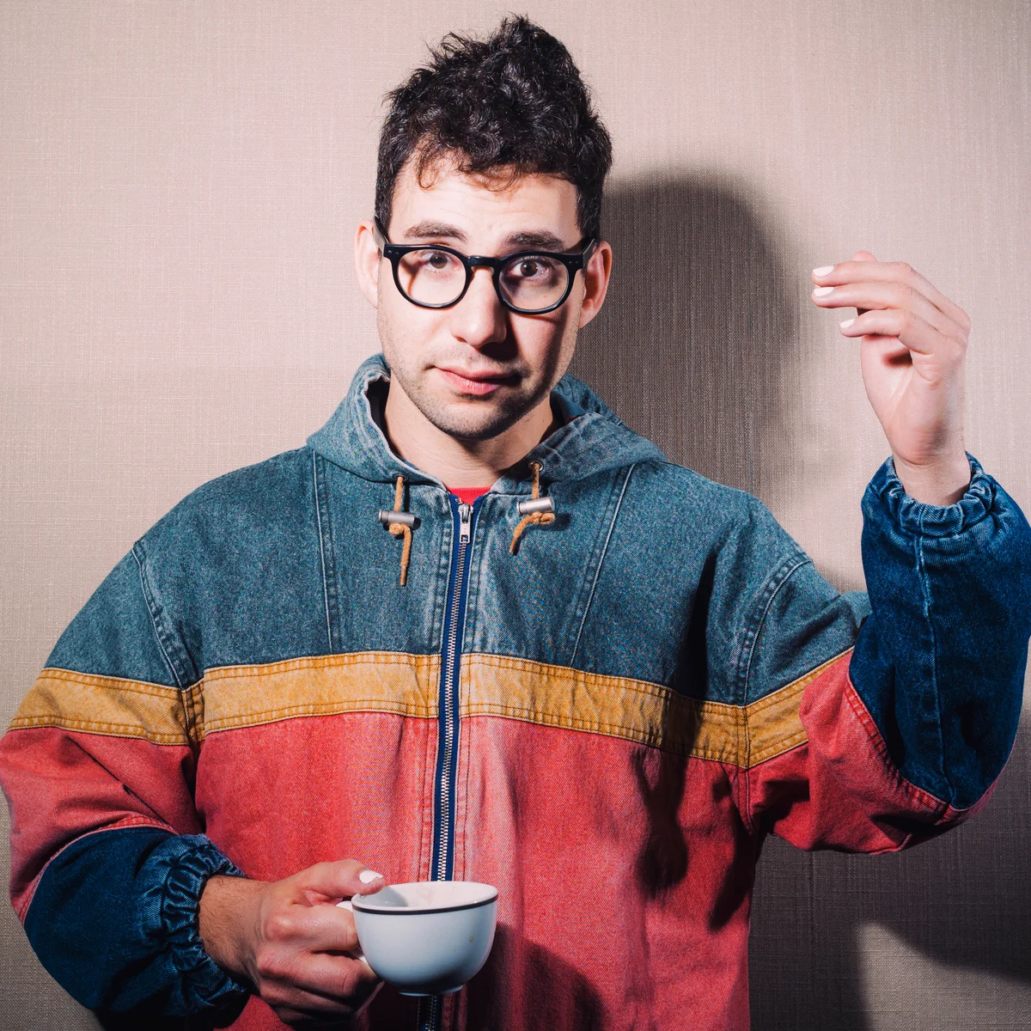
Notes:
Jack Antonoff

Slide 14
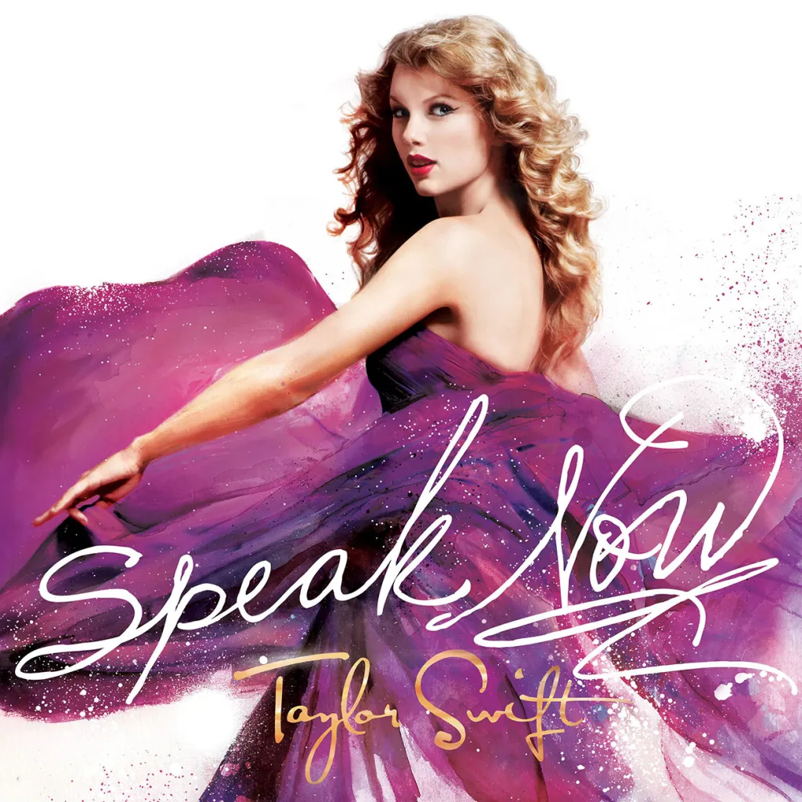
Notes:
Speak Now

Slide 15
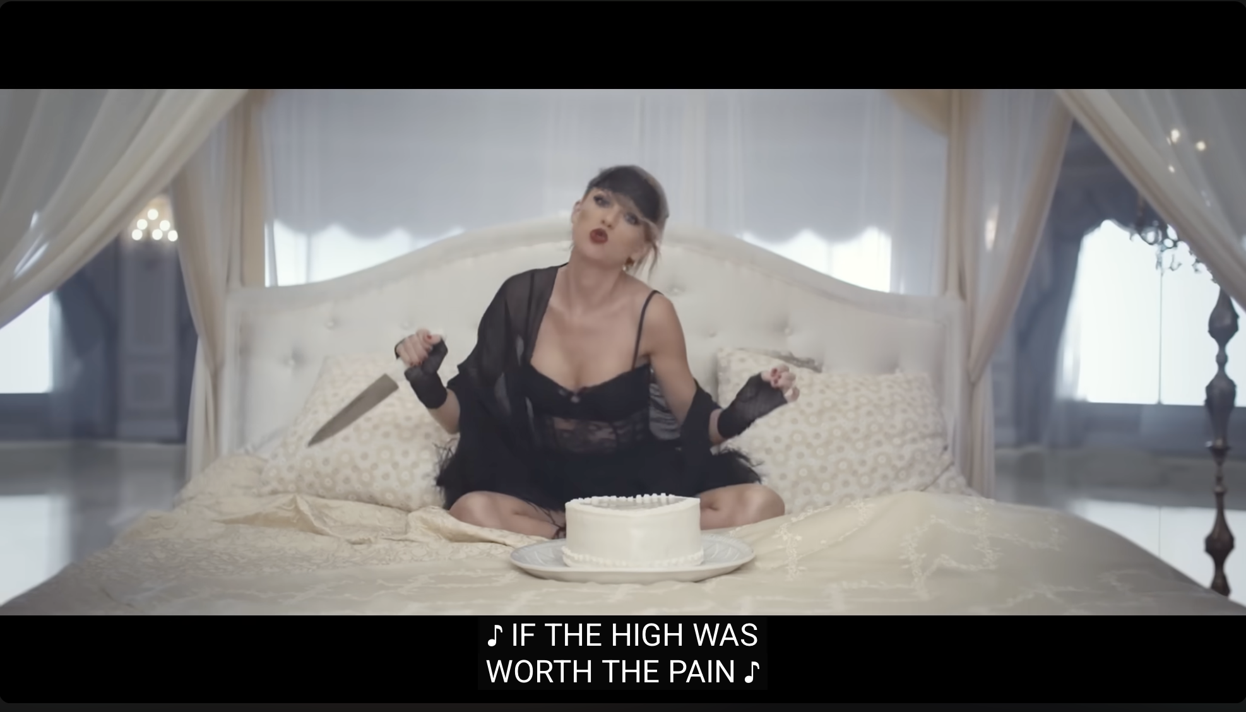
Notes:
Blank Space

Slide 16
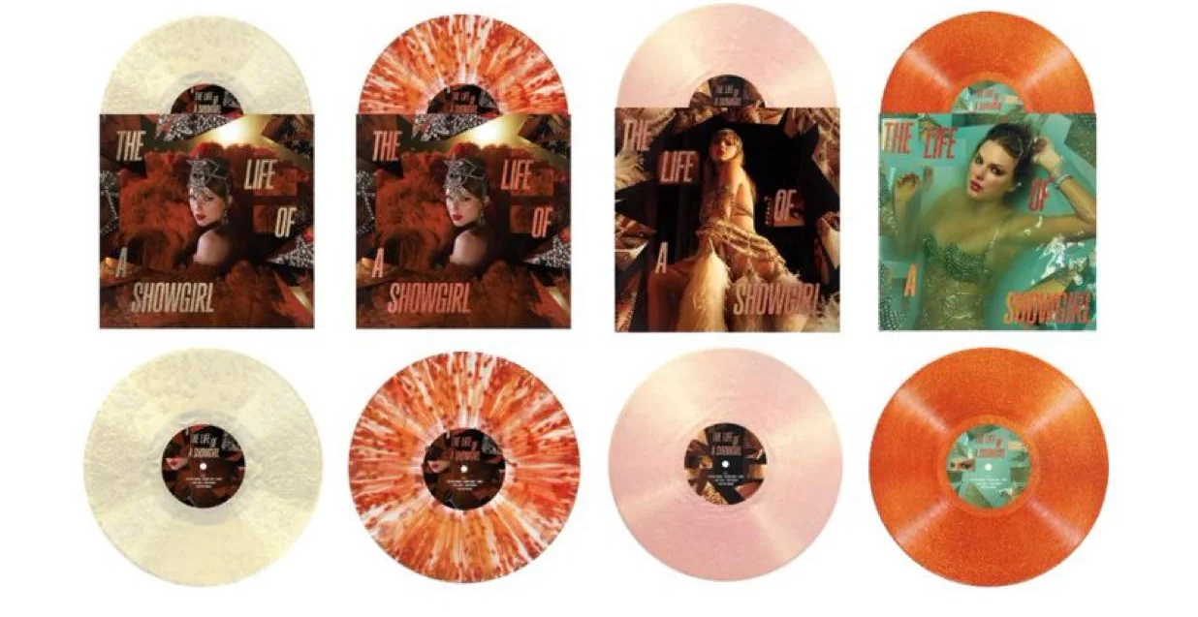
Notes:
Viny

Slide 17
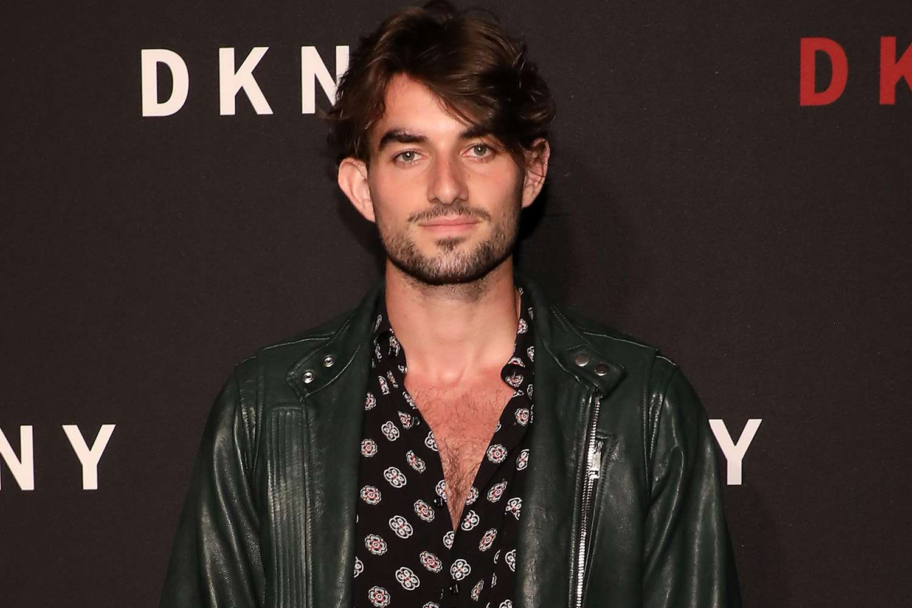
Notes:
Conor Kennedy

Slide 18
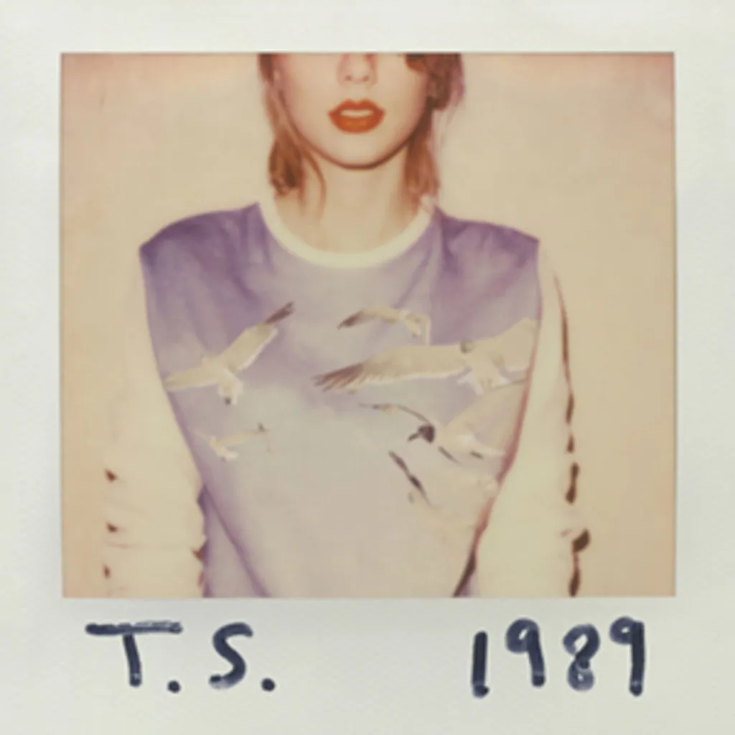
Notes:
1989

Slide 19
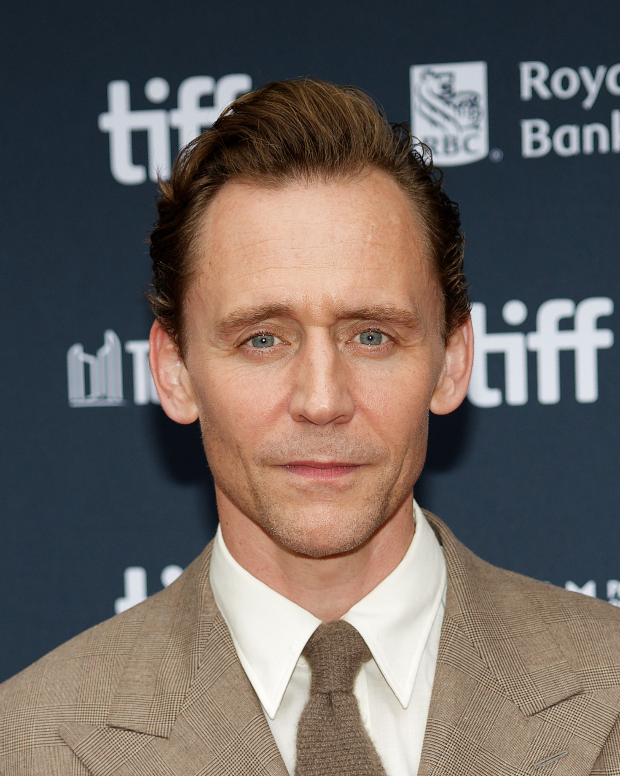
Notes:
Tom Hiddleston

Slide 20
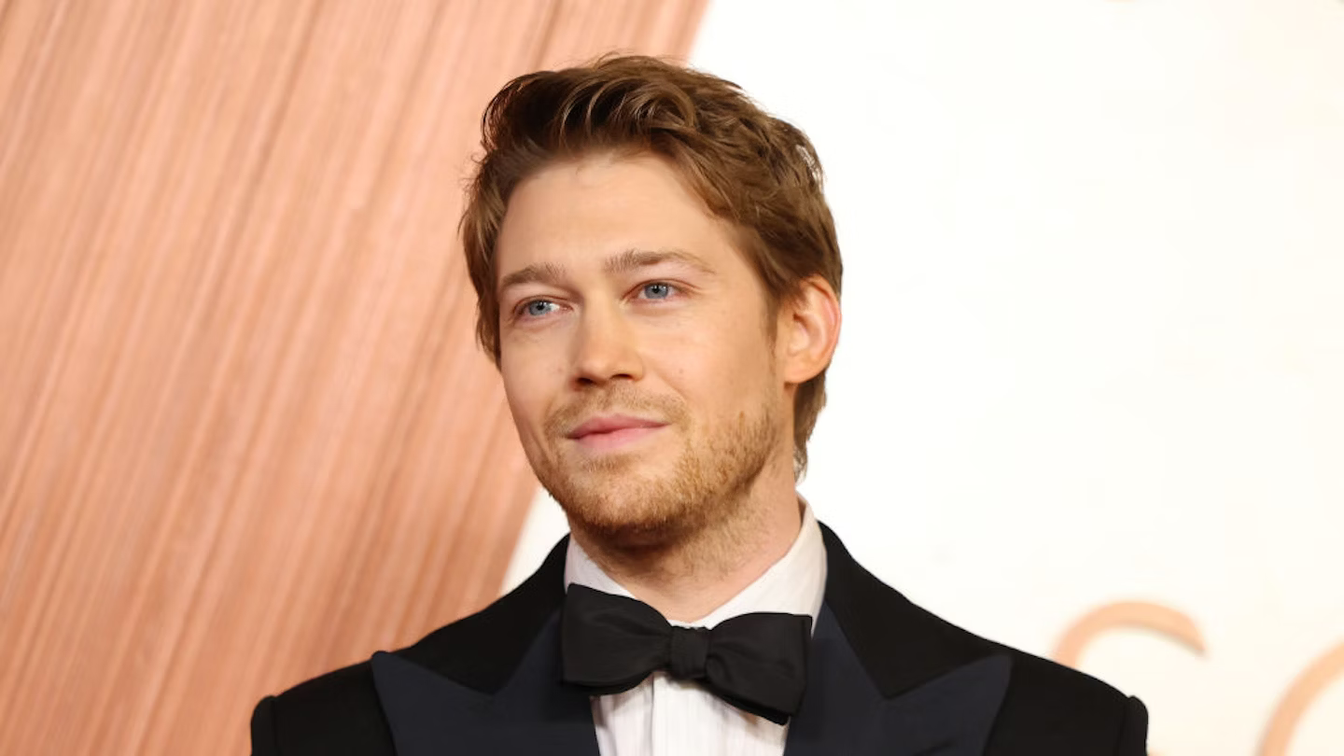
Notes:
Joe Alwyn

Slide 21
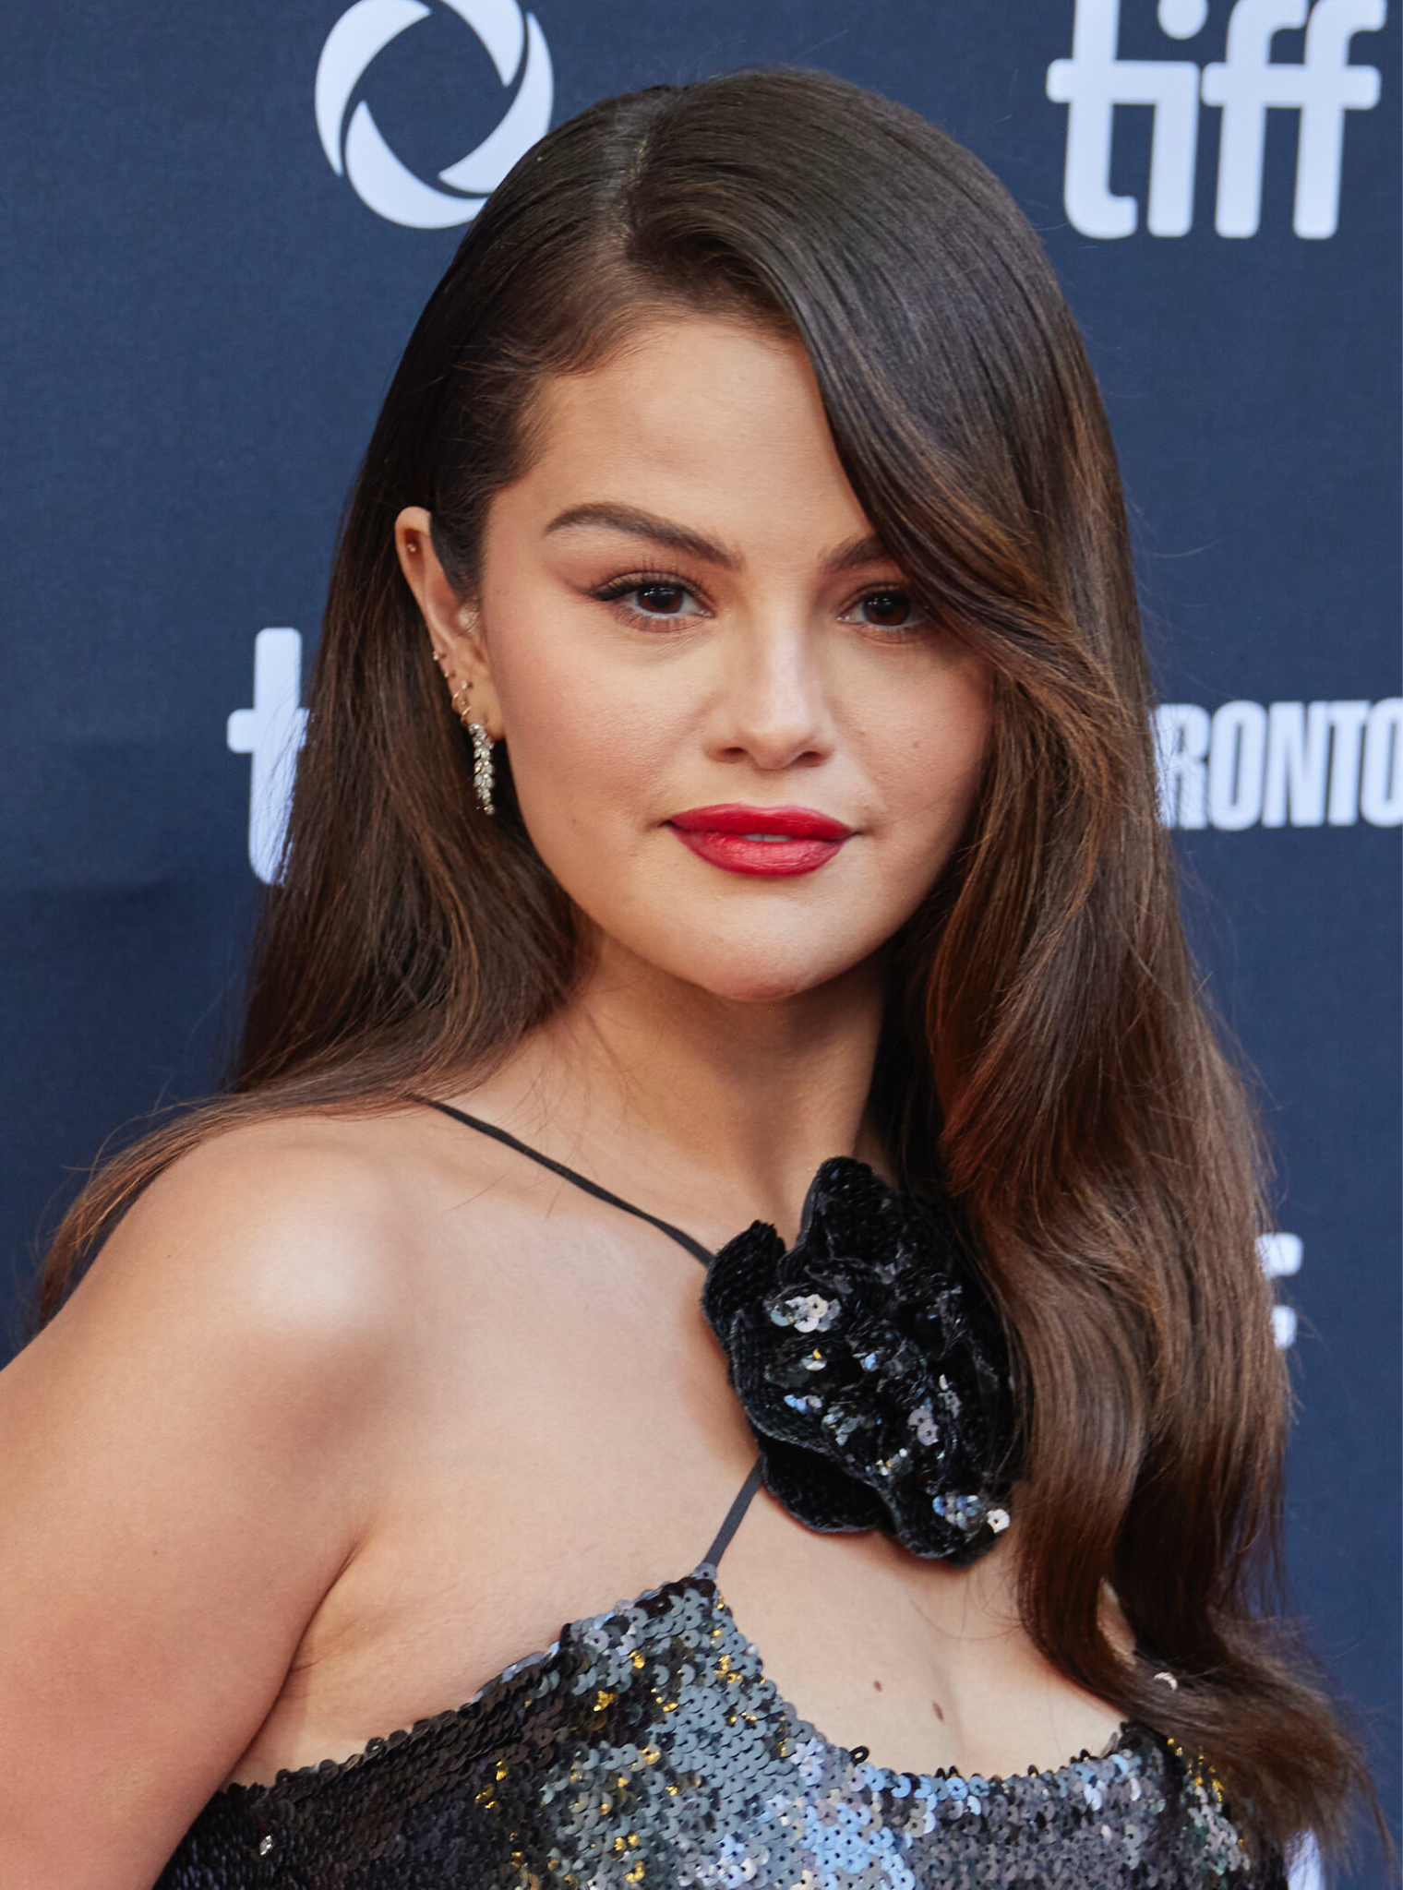
Notes:
Selena Gomez

Slide 22
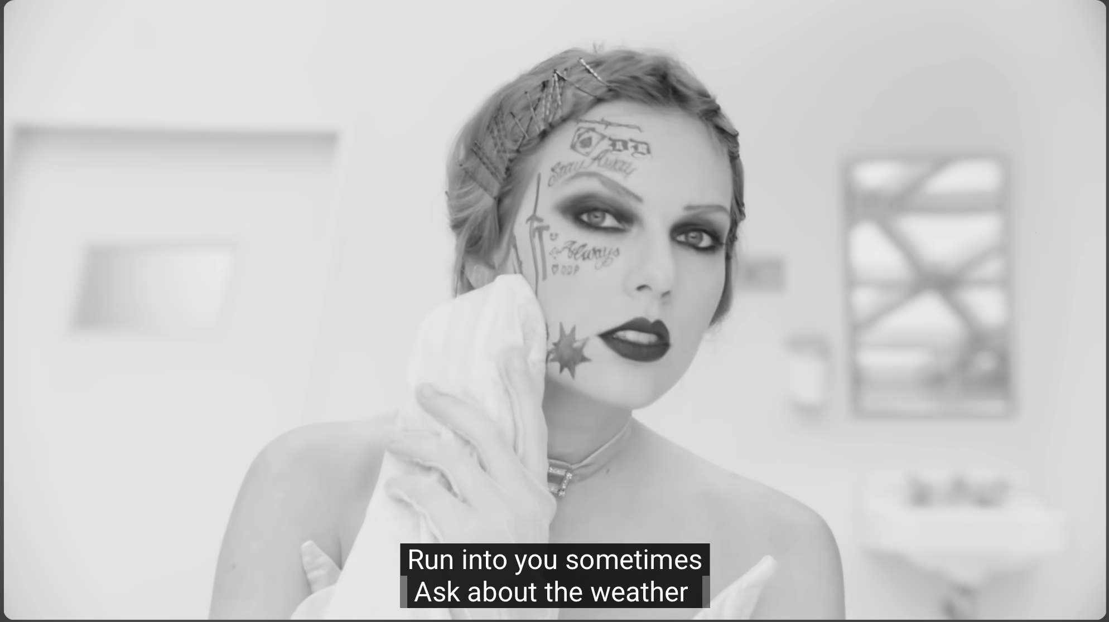
Notes:
Fortnight

Slide 23
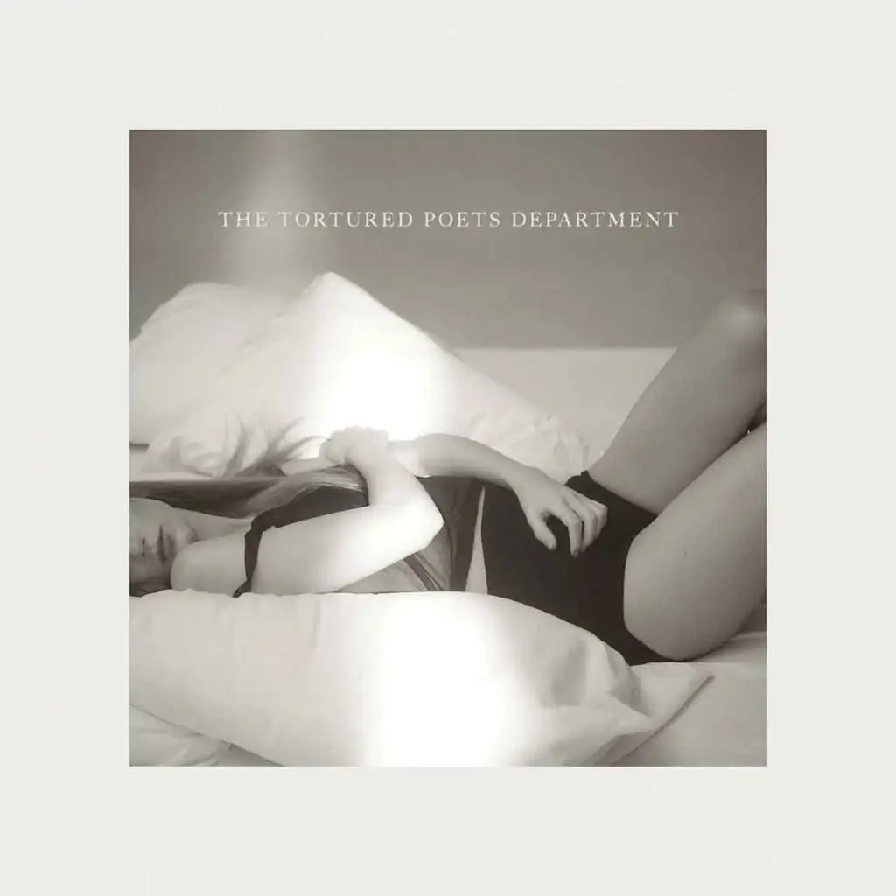
Notes:
The Tortured Poets Department

Slide 24
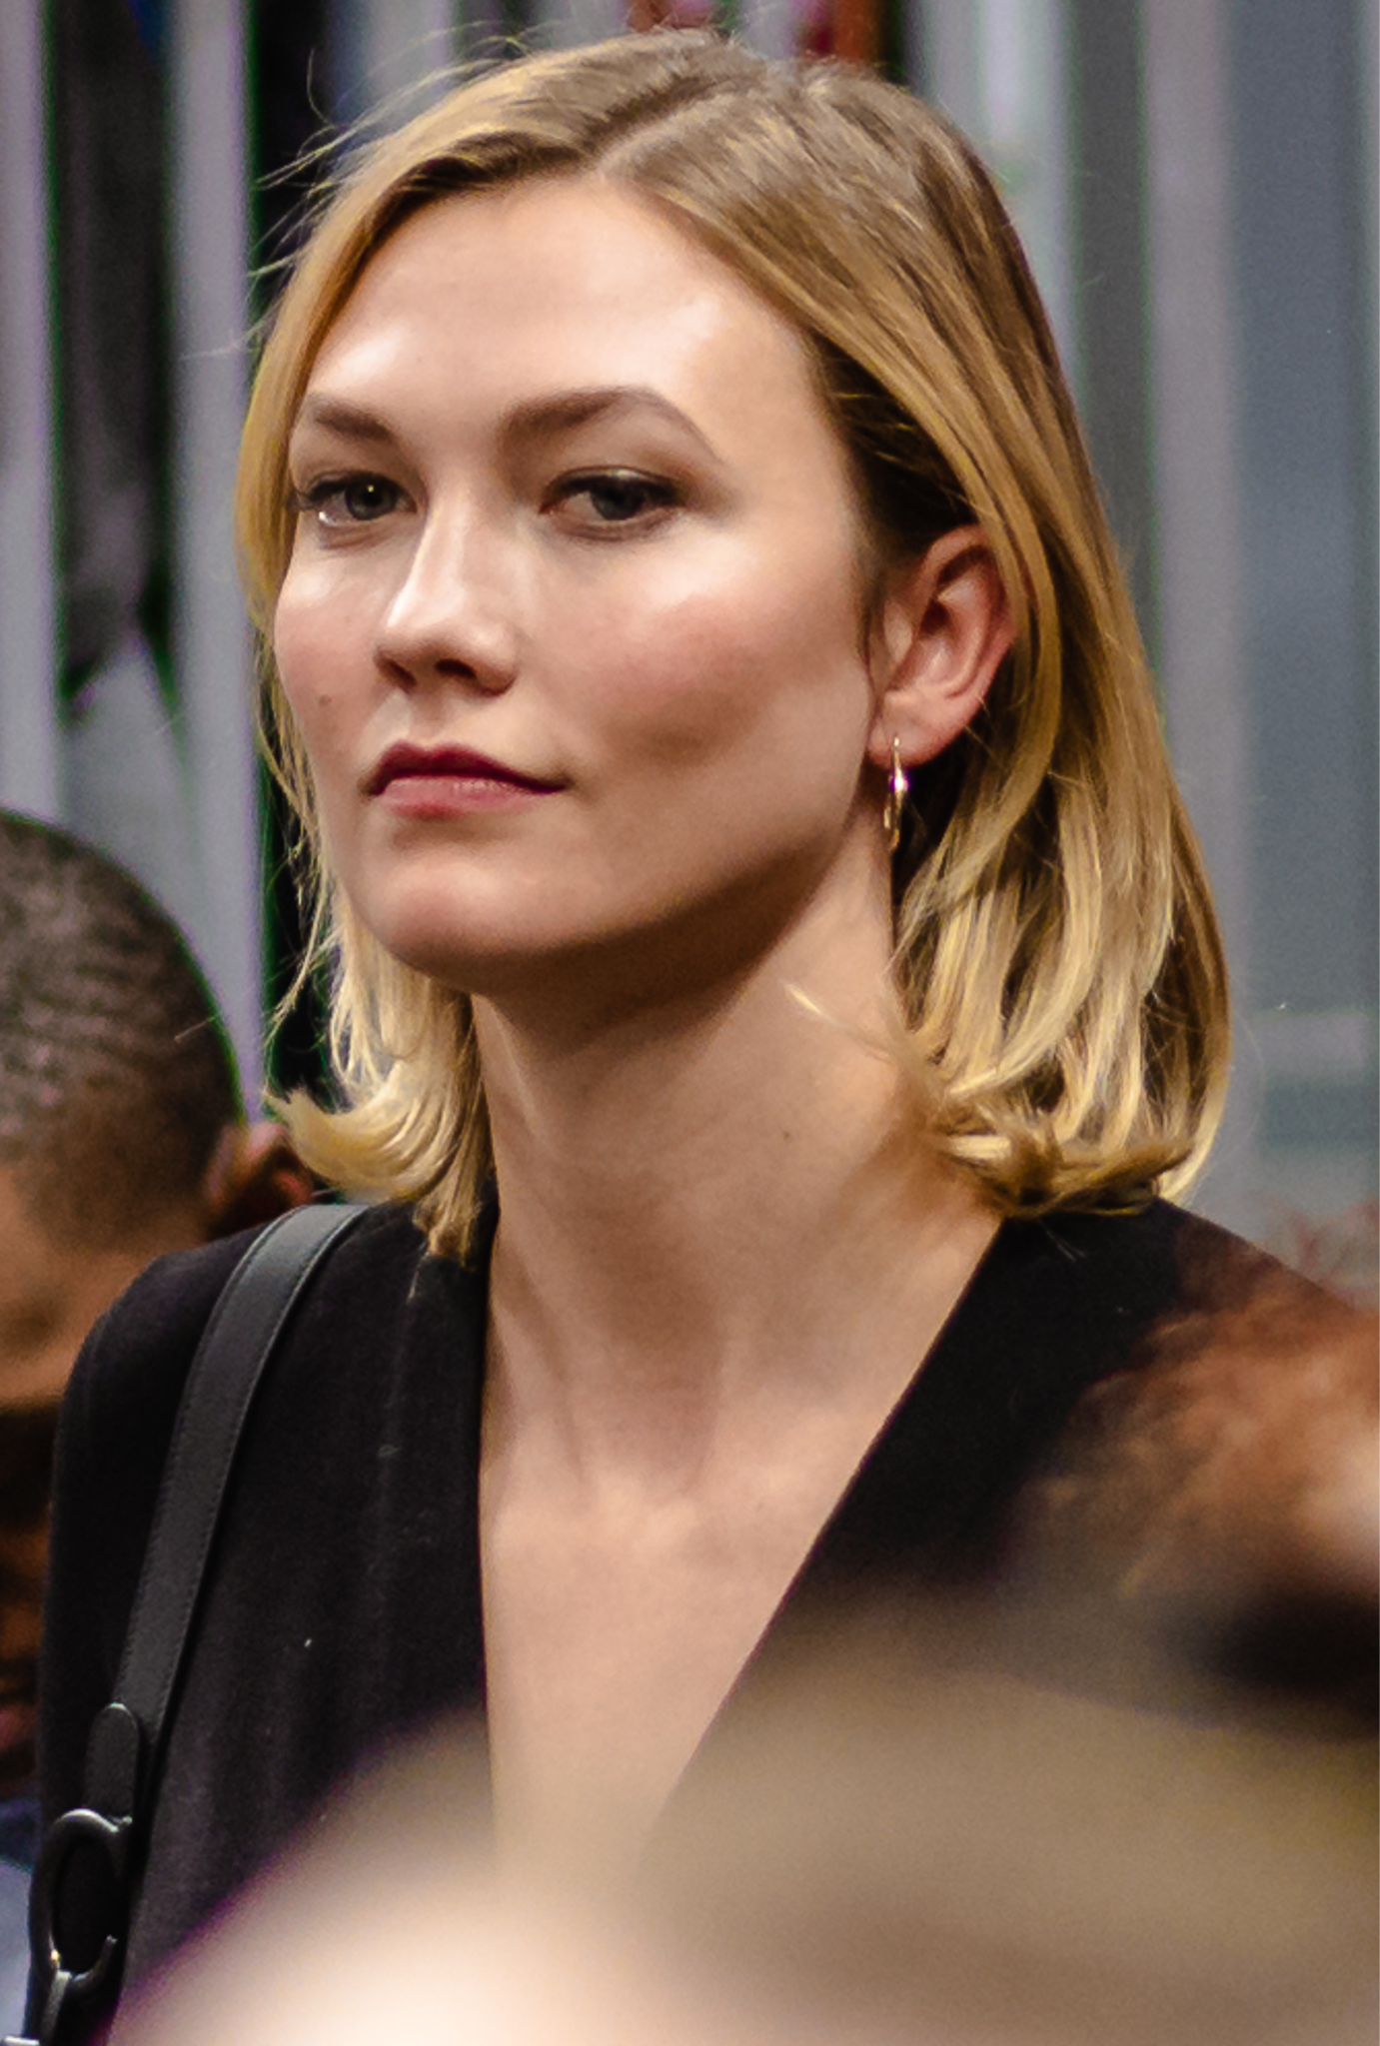
Notes:
Karlie Kloss

Slide 25
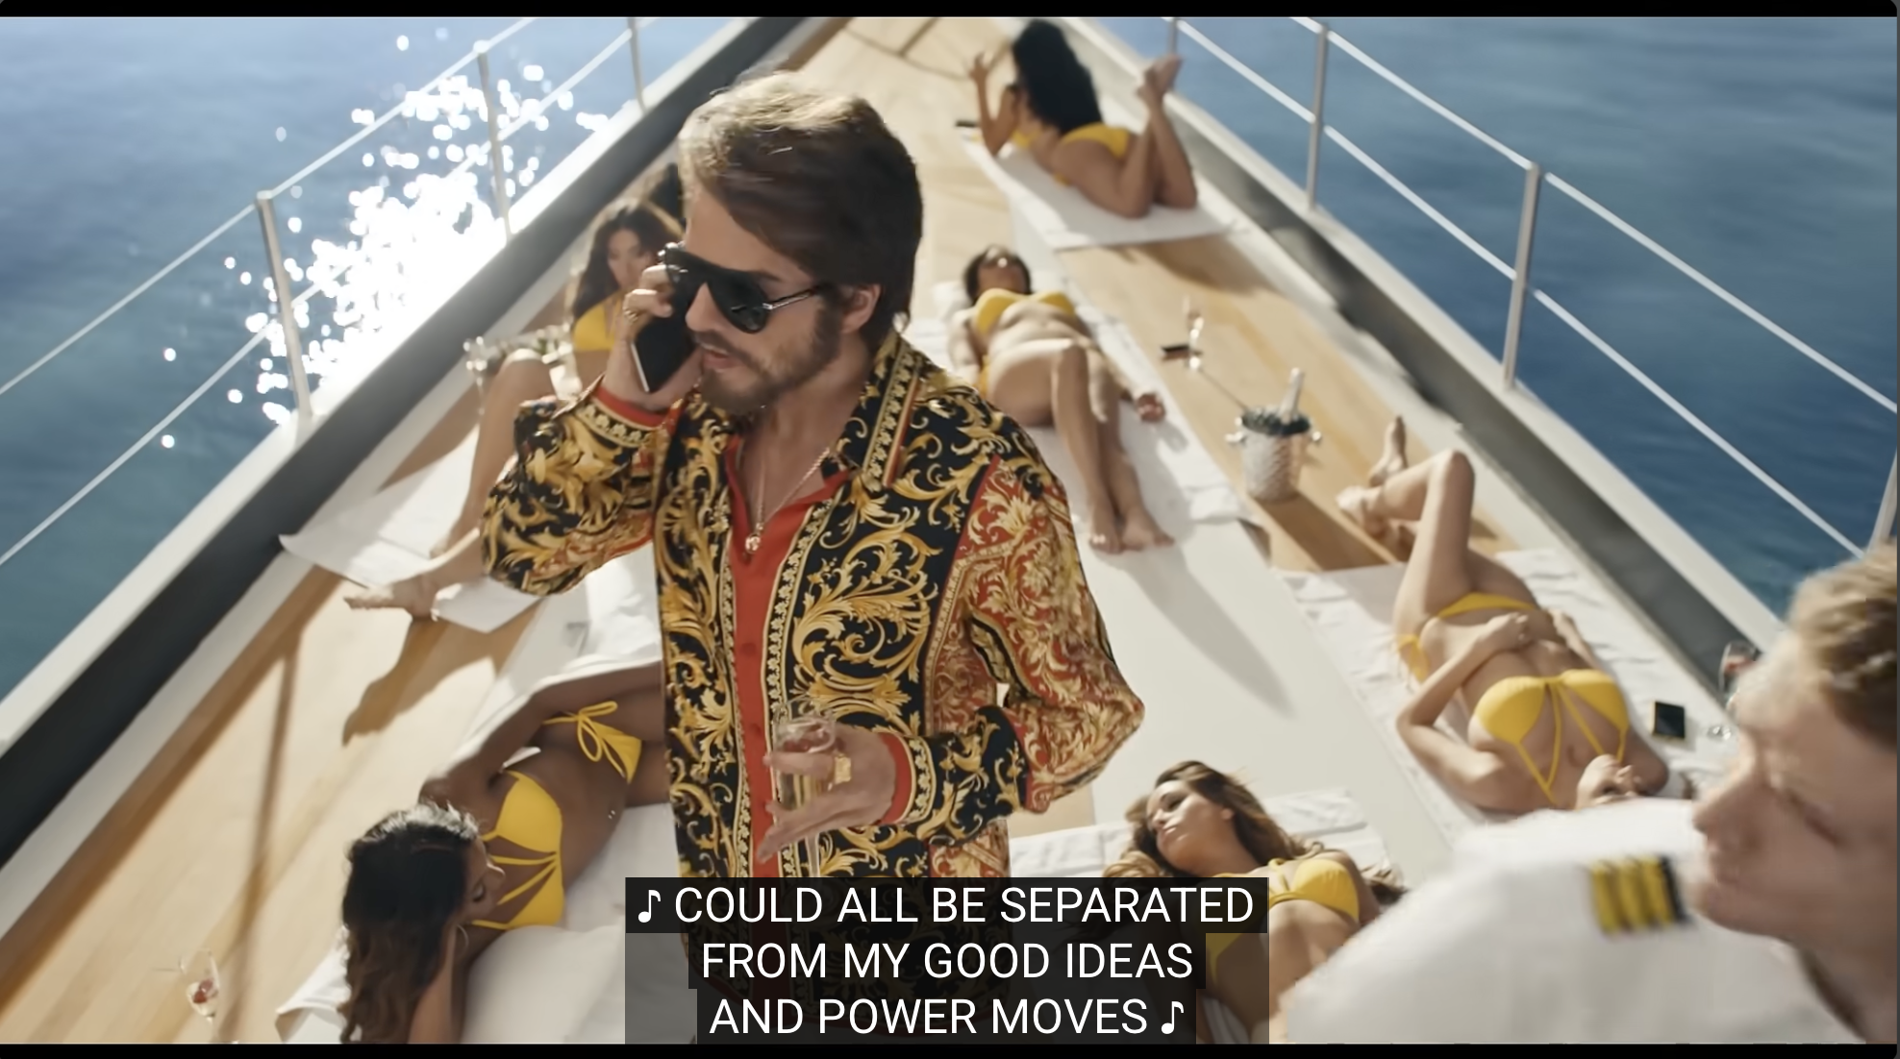
Notes:
The Man

Slide 26

Notes:
Meredith Grey

Slide 27
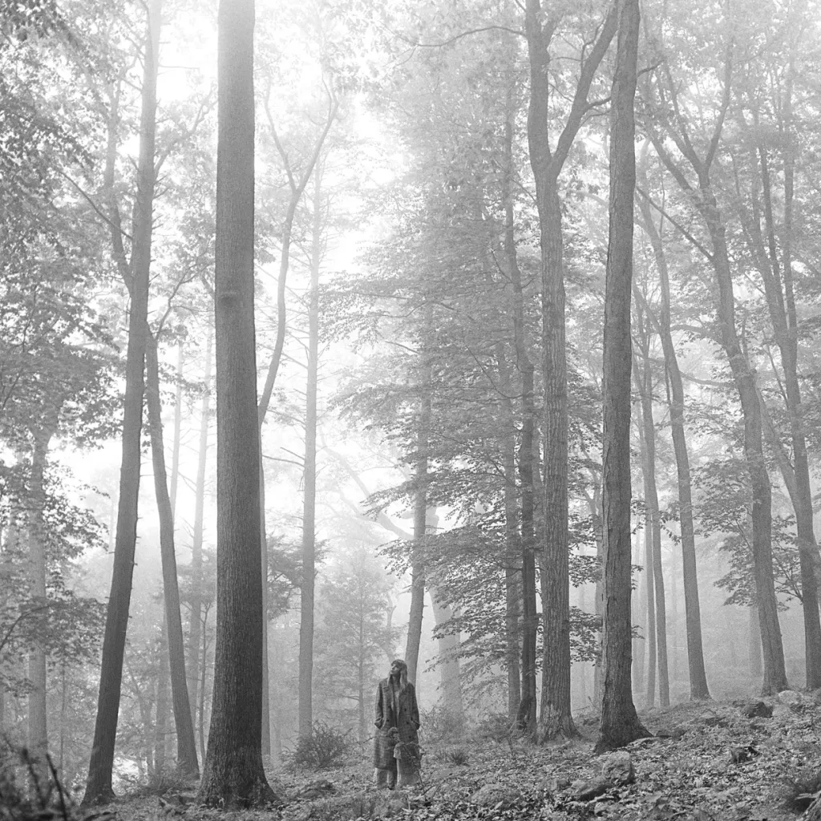
Notes:
Folklore

Slide 28
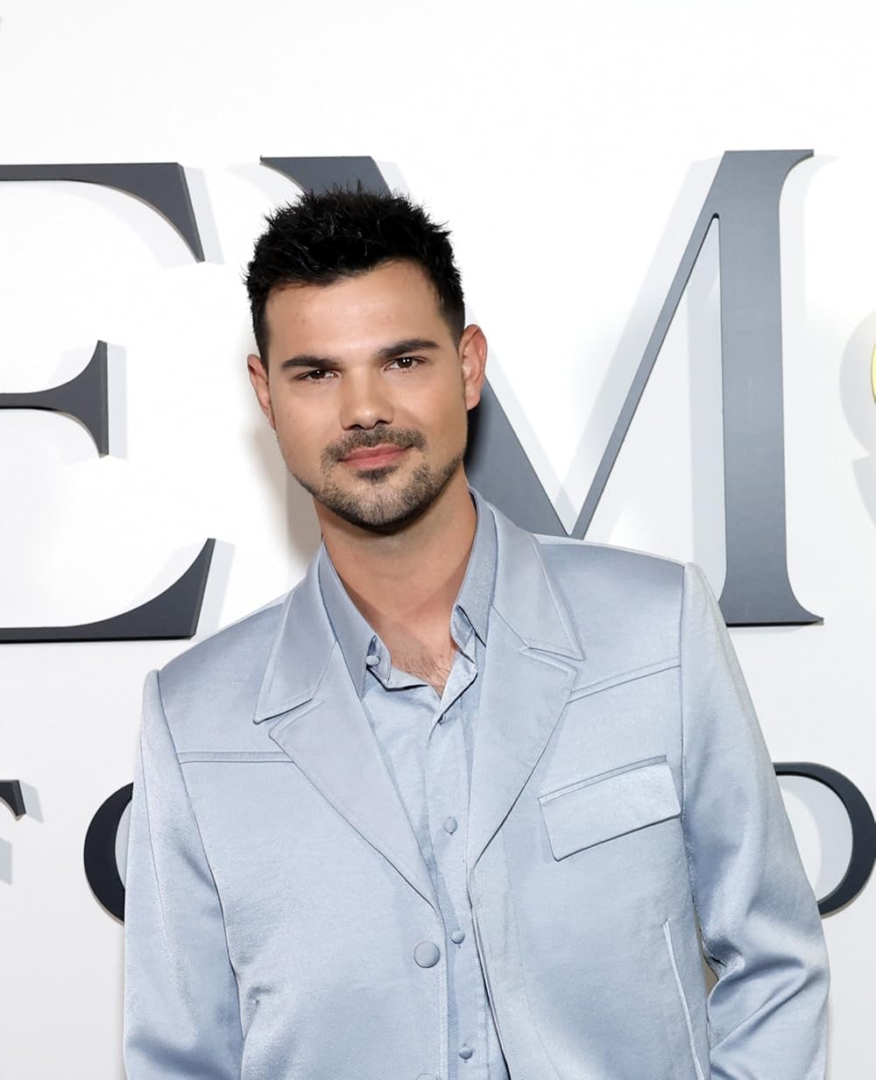
Notes:
Taylor Lautner

Slide 29
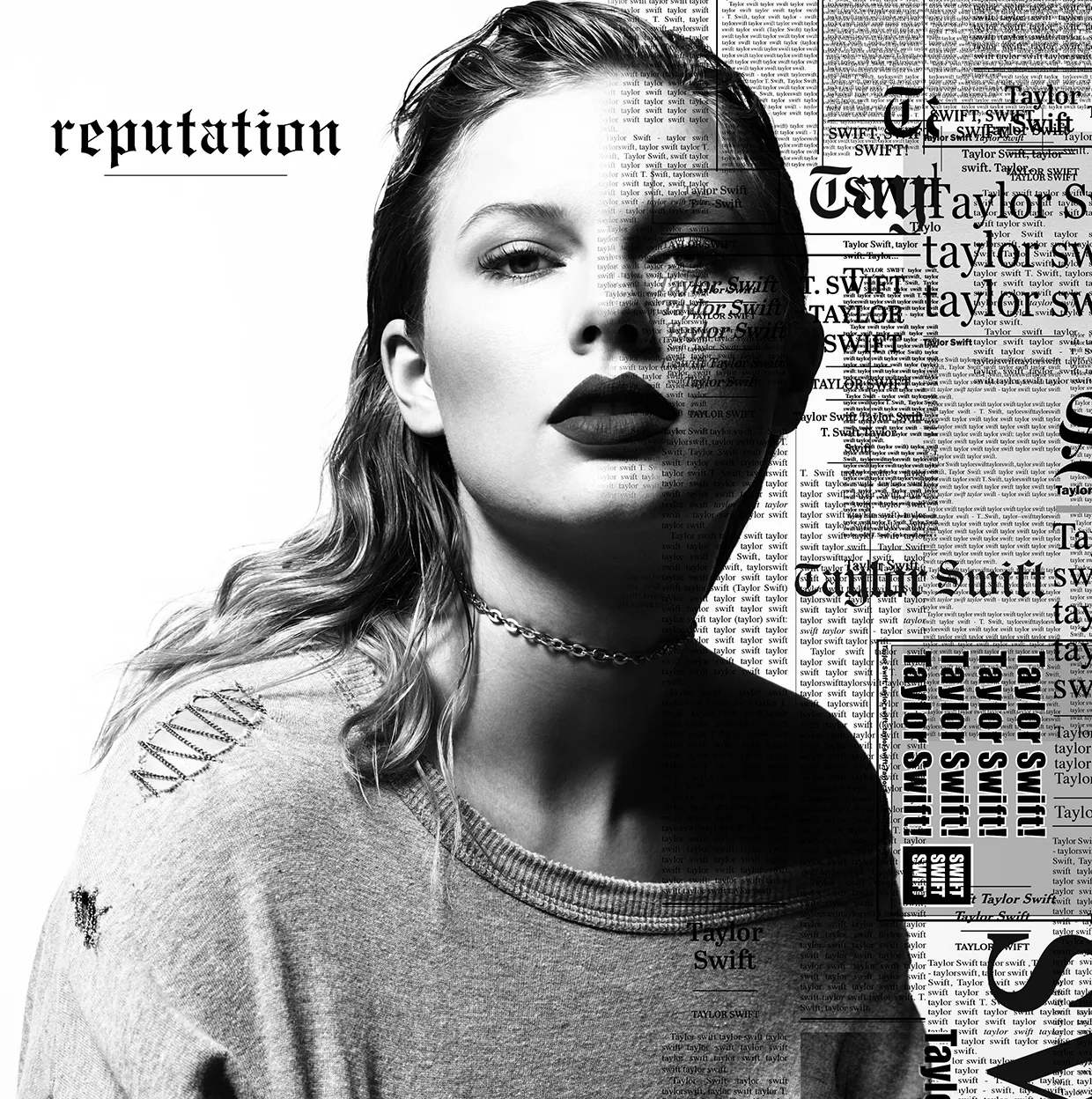
Notes:
Reputation

Slide 30
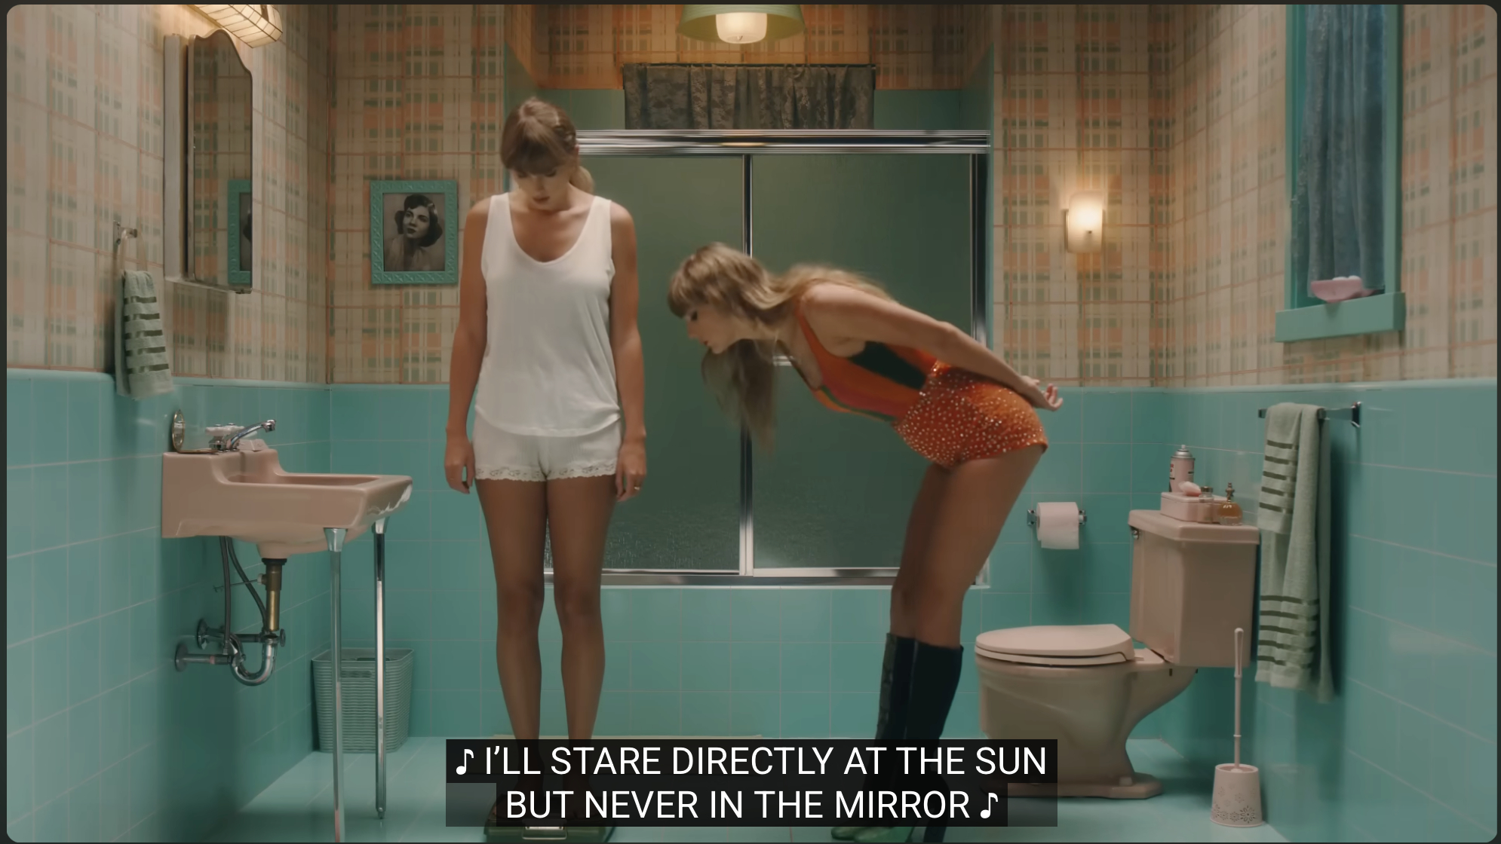
Notes:
Anti Hero

Slide 31
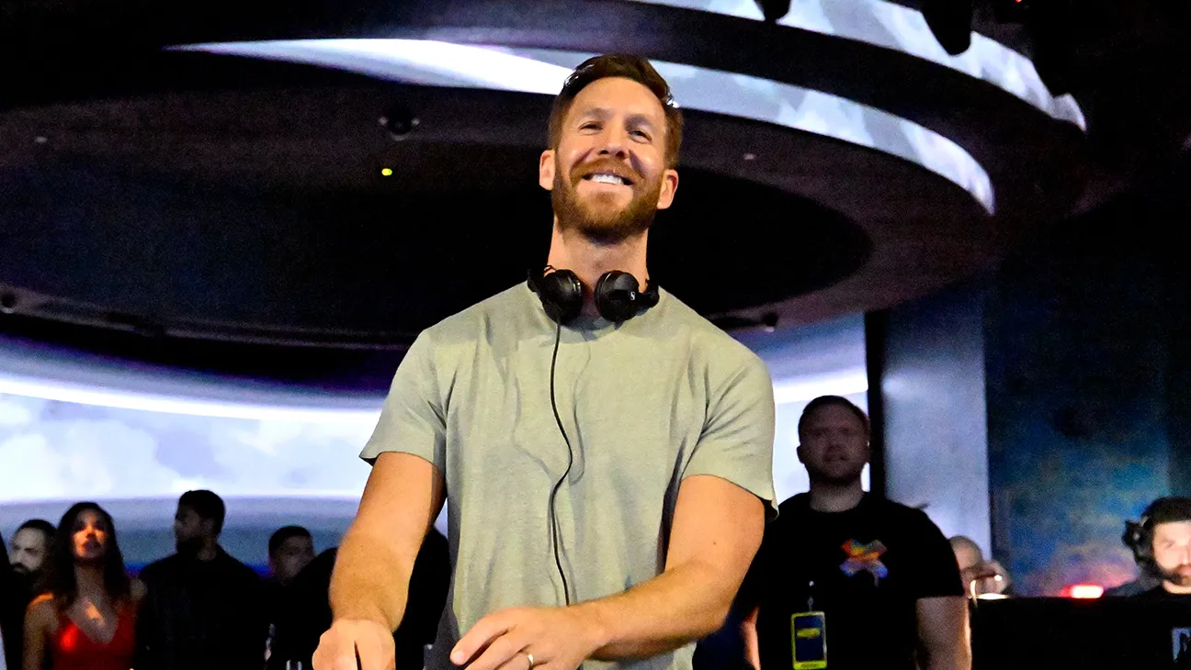
Notes:
Calvin Harris

Slide 32
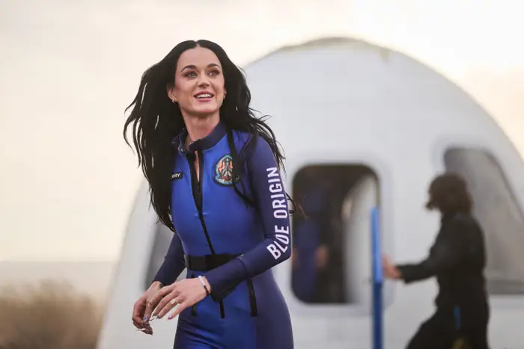
Notes:
Katy Perry

Slide 33
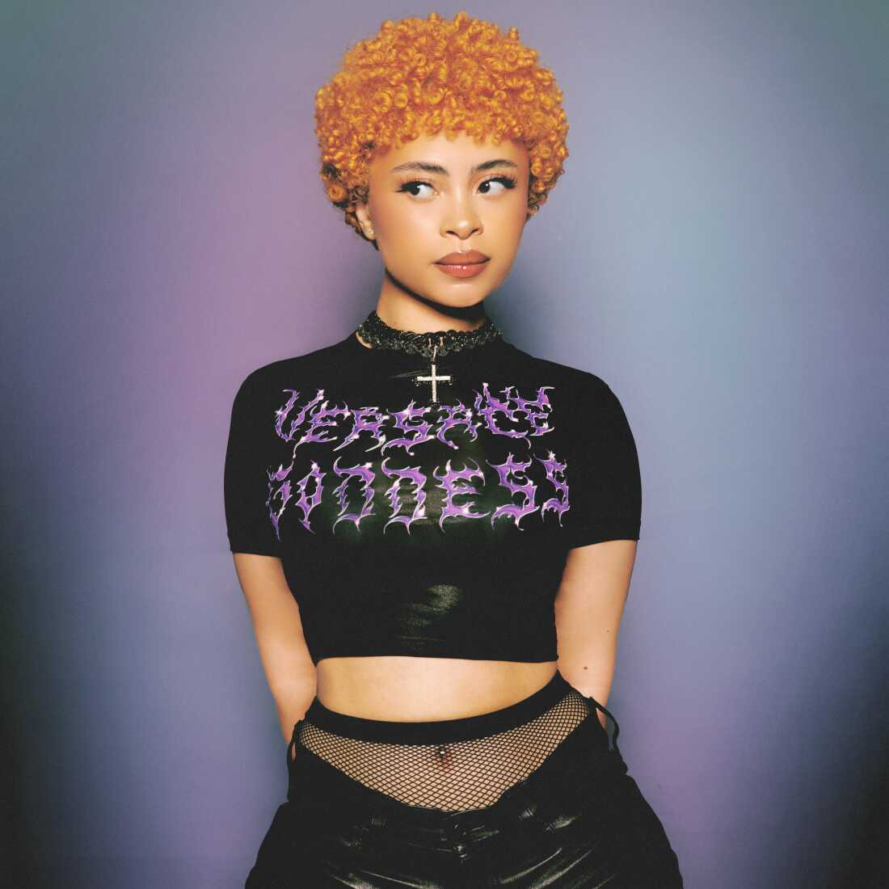
Notes:
Ice Spice

Slide 34
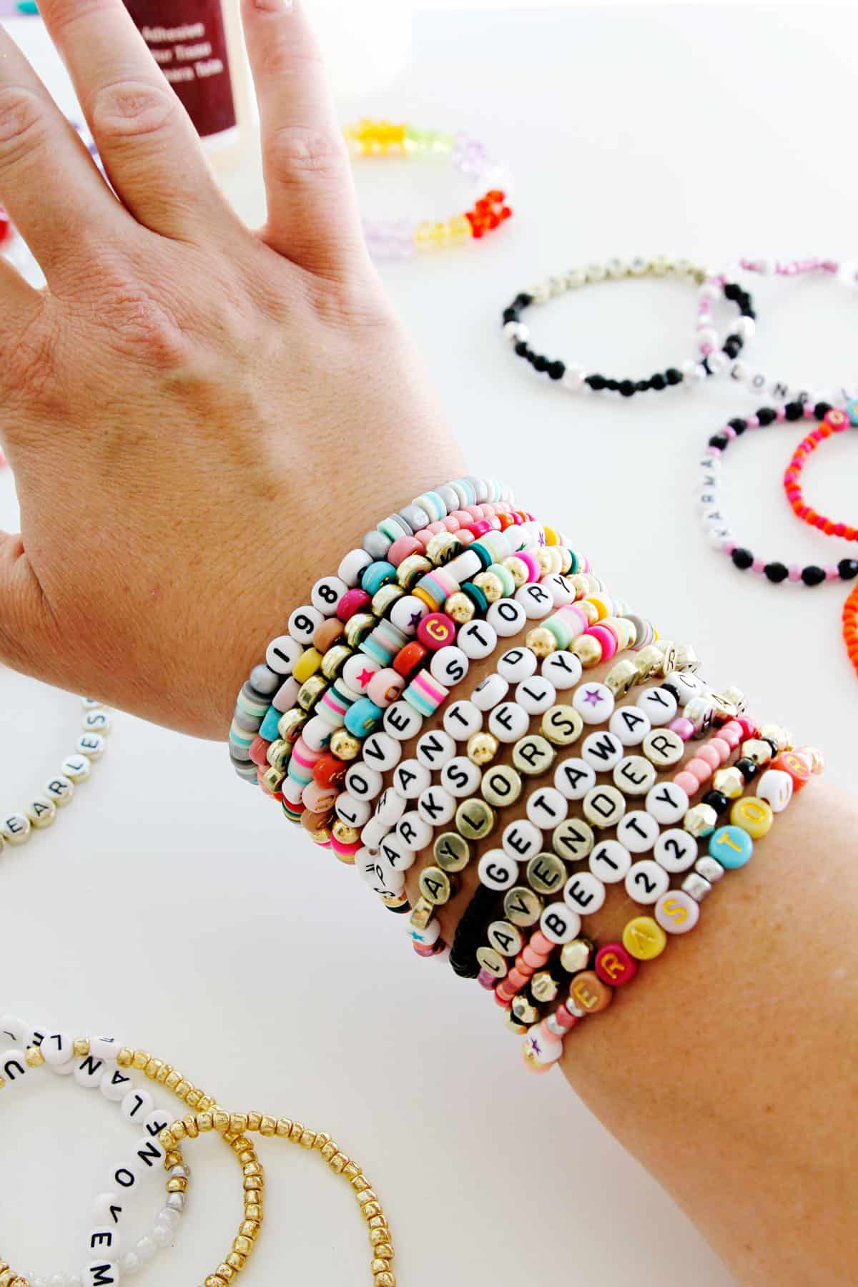
Notes:
Friendship bracelet

Slide 35
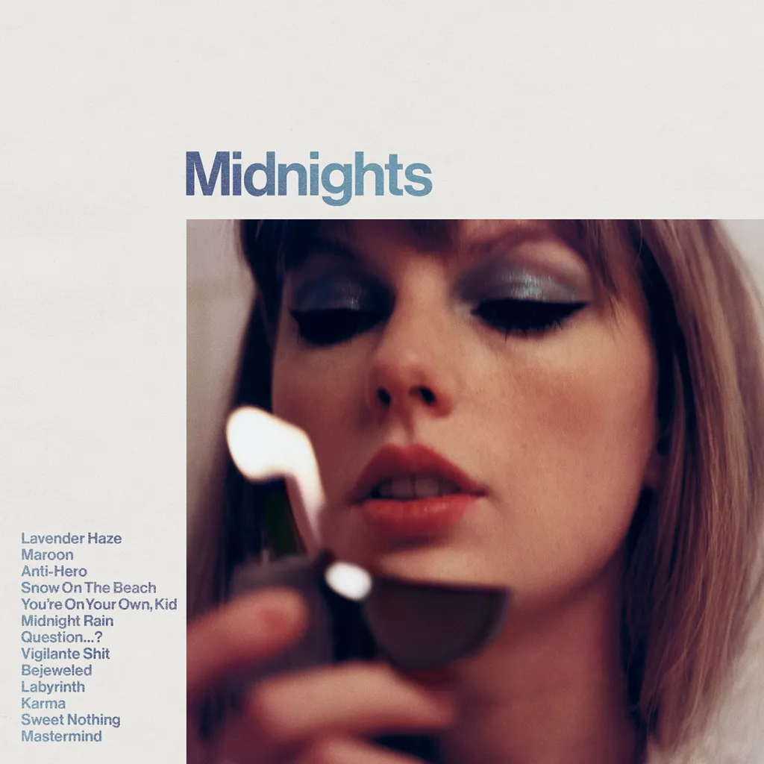
Notes:
Midnights

Slide 36
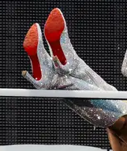
Notes:
Louboutin

Slide 37
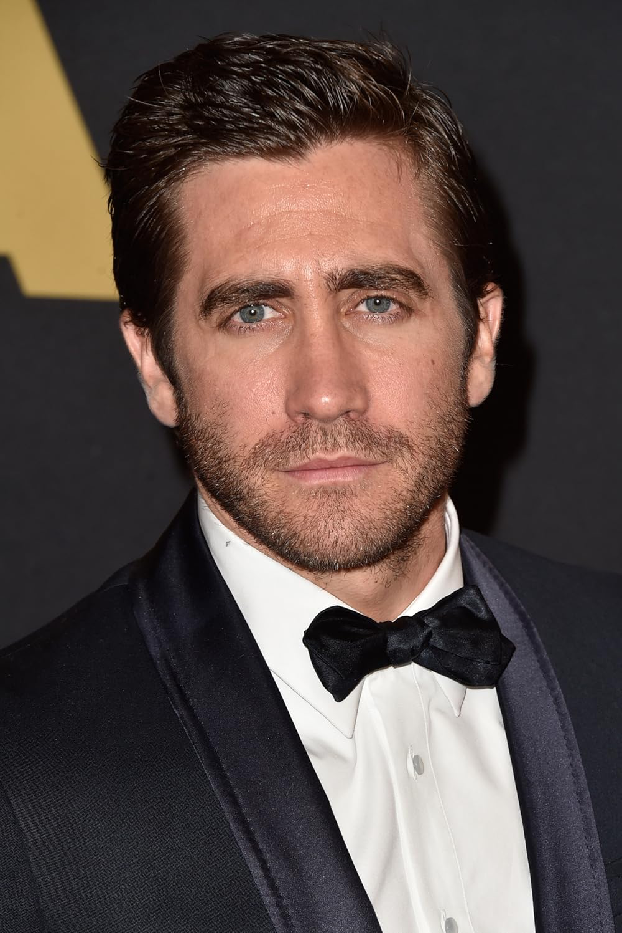
Notes:
Jake Gyllenhall

Slide 38
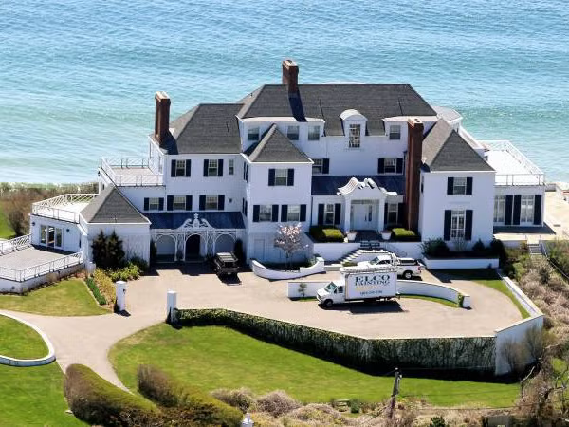
Notes:
Holiday House

Slide 39
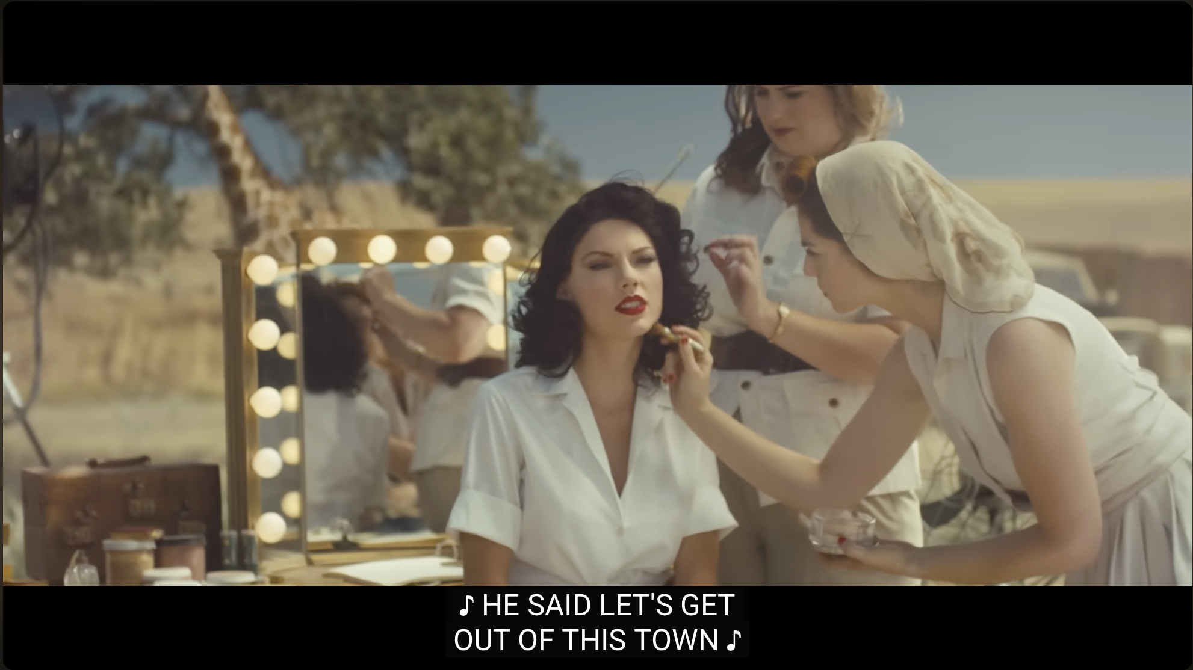
Notes:
Wildest Dreams

Slide 40
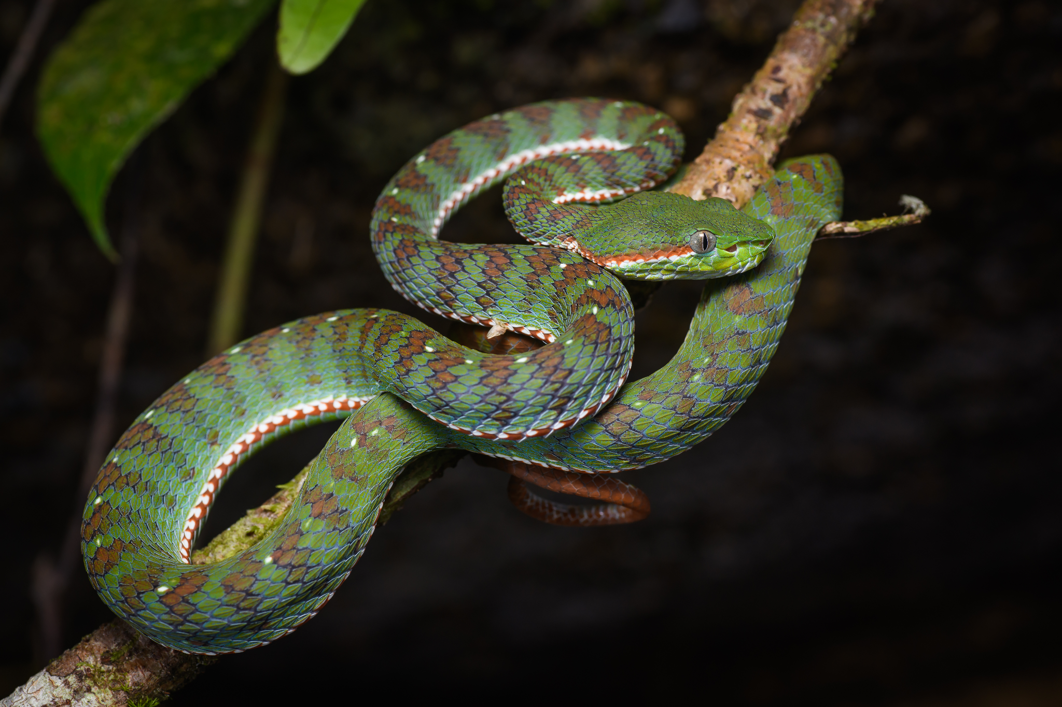
Notes:
Snake

Slide 41
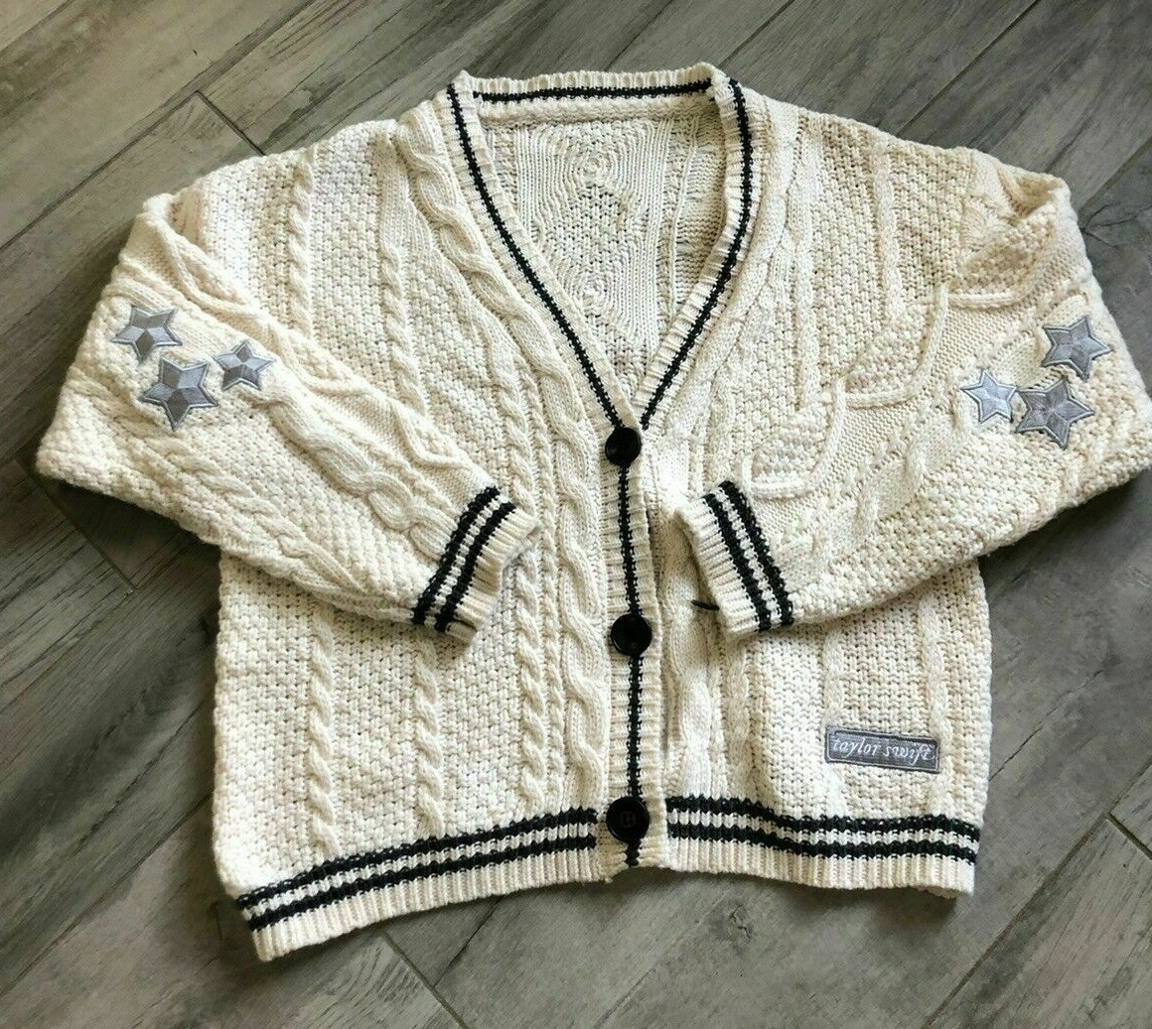
Notes:
Cardigan

Slide 42
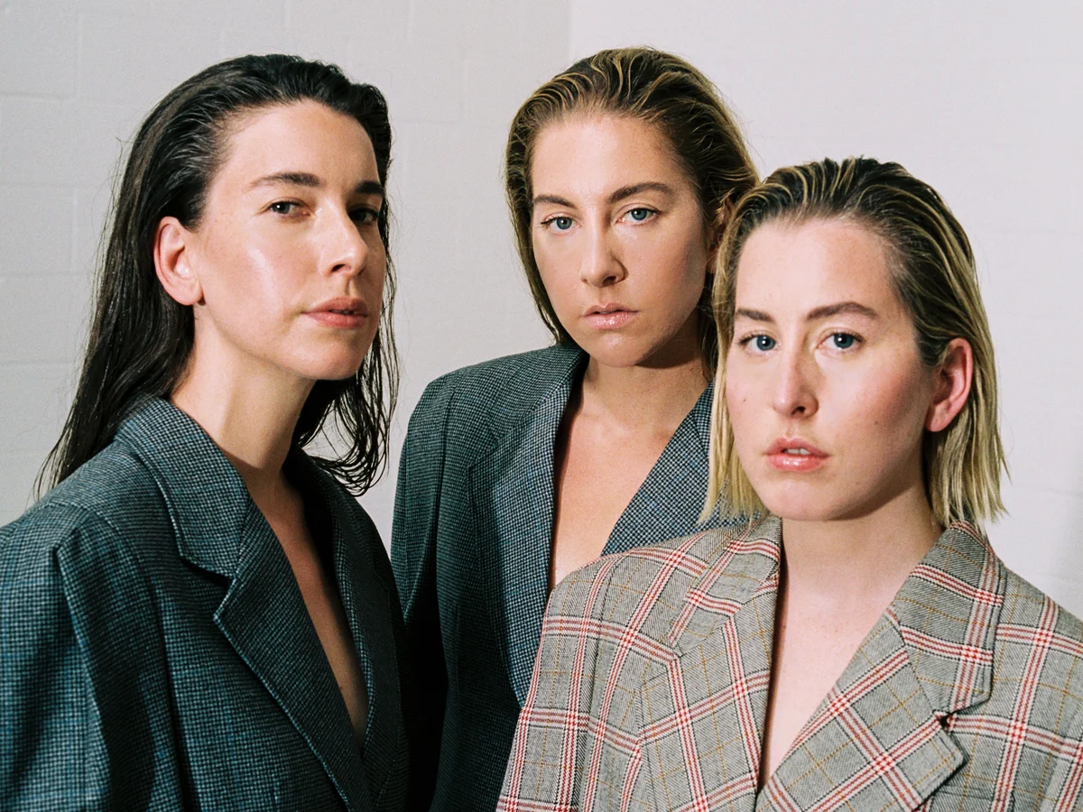
Notes:
Haim

Slide 43
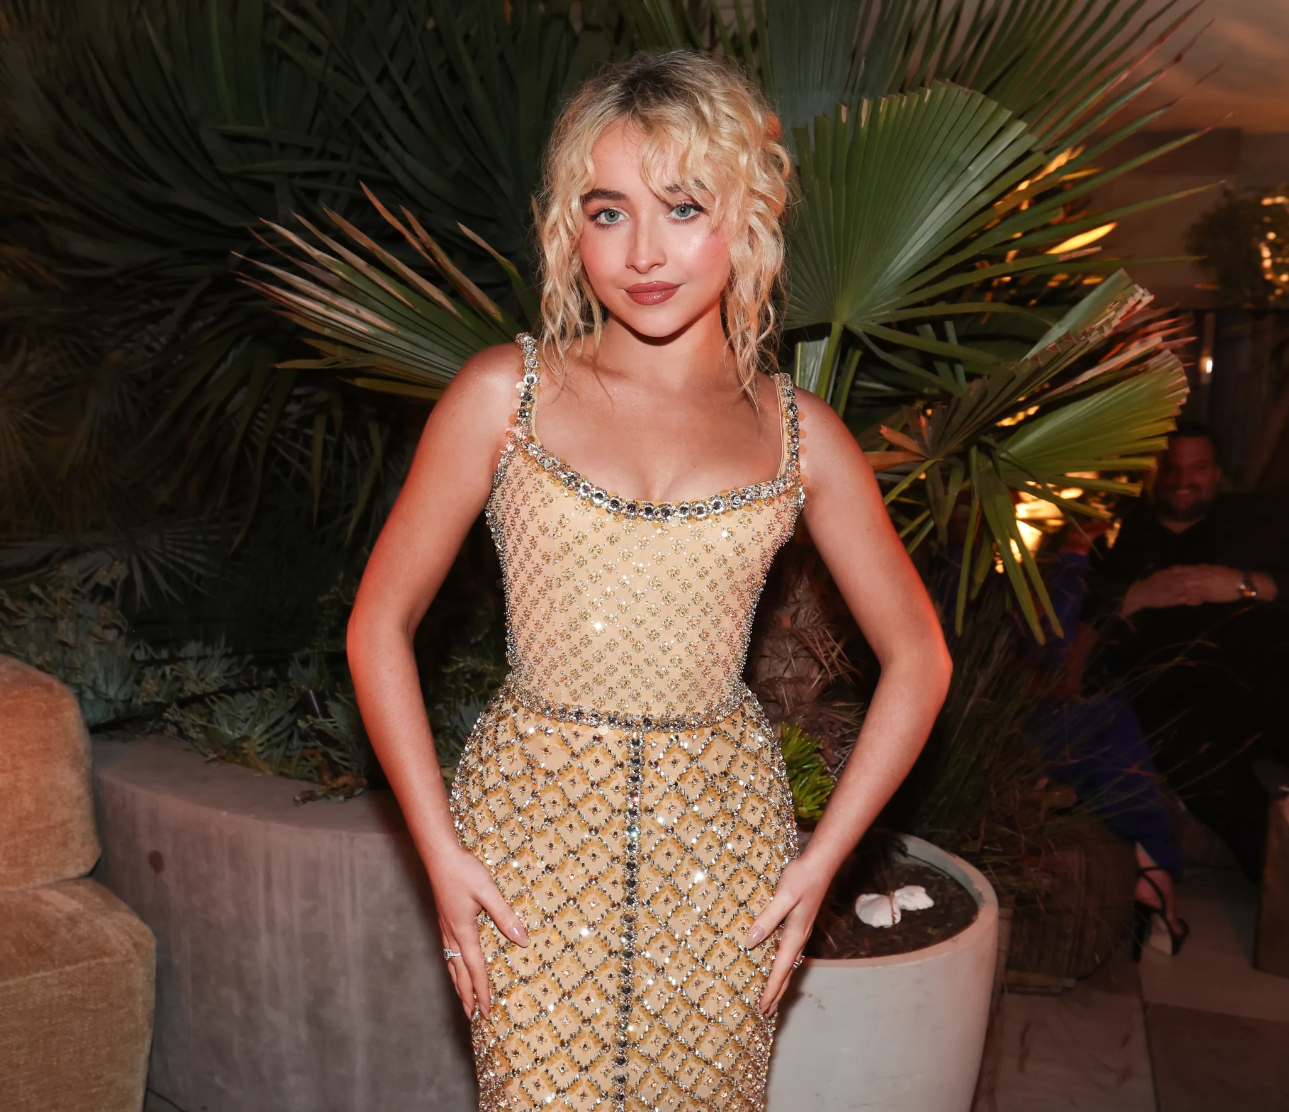
Notes:
Sabrina Carpenter

Slide 44
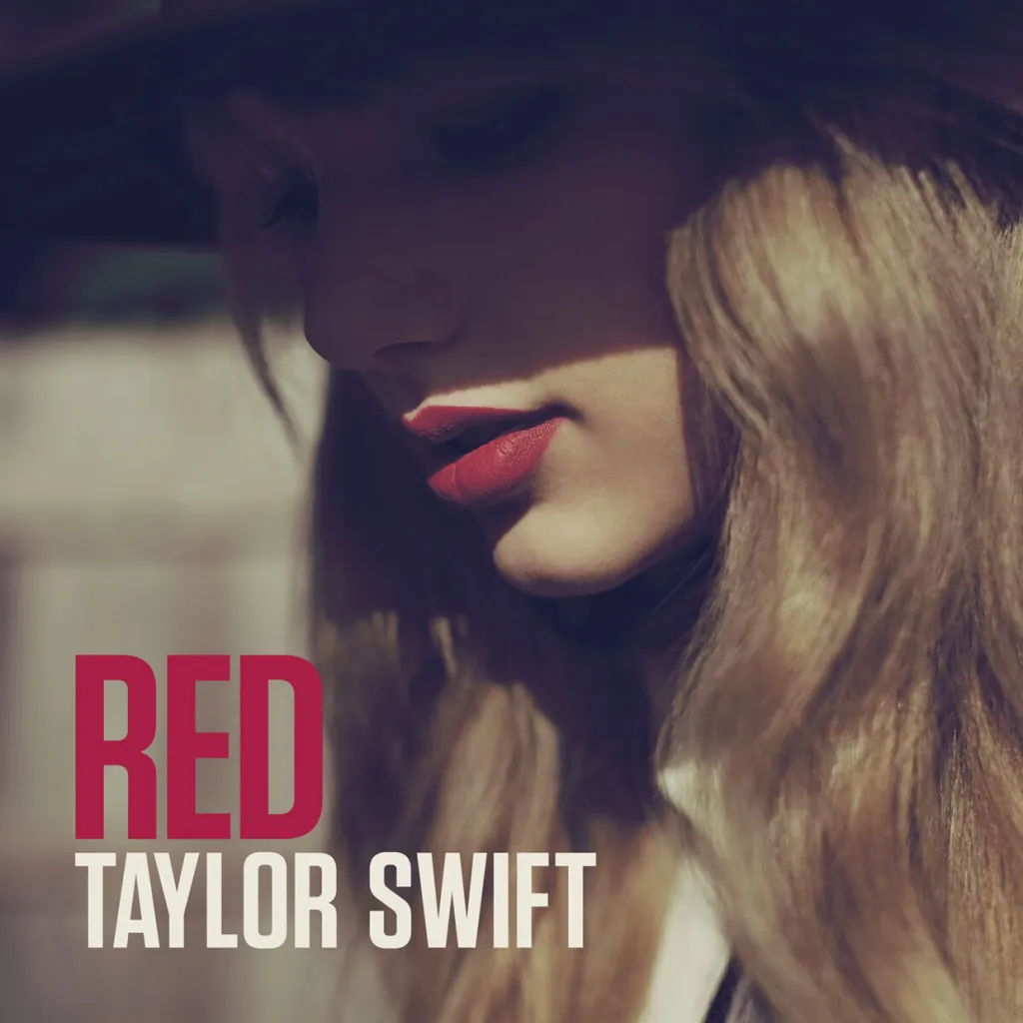
Notes:
Red

Slide 45
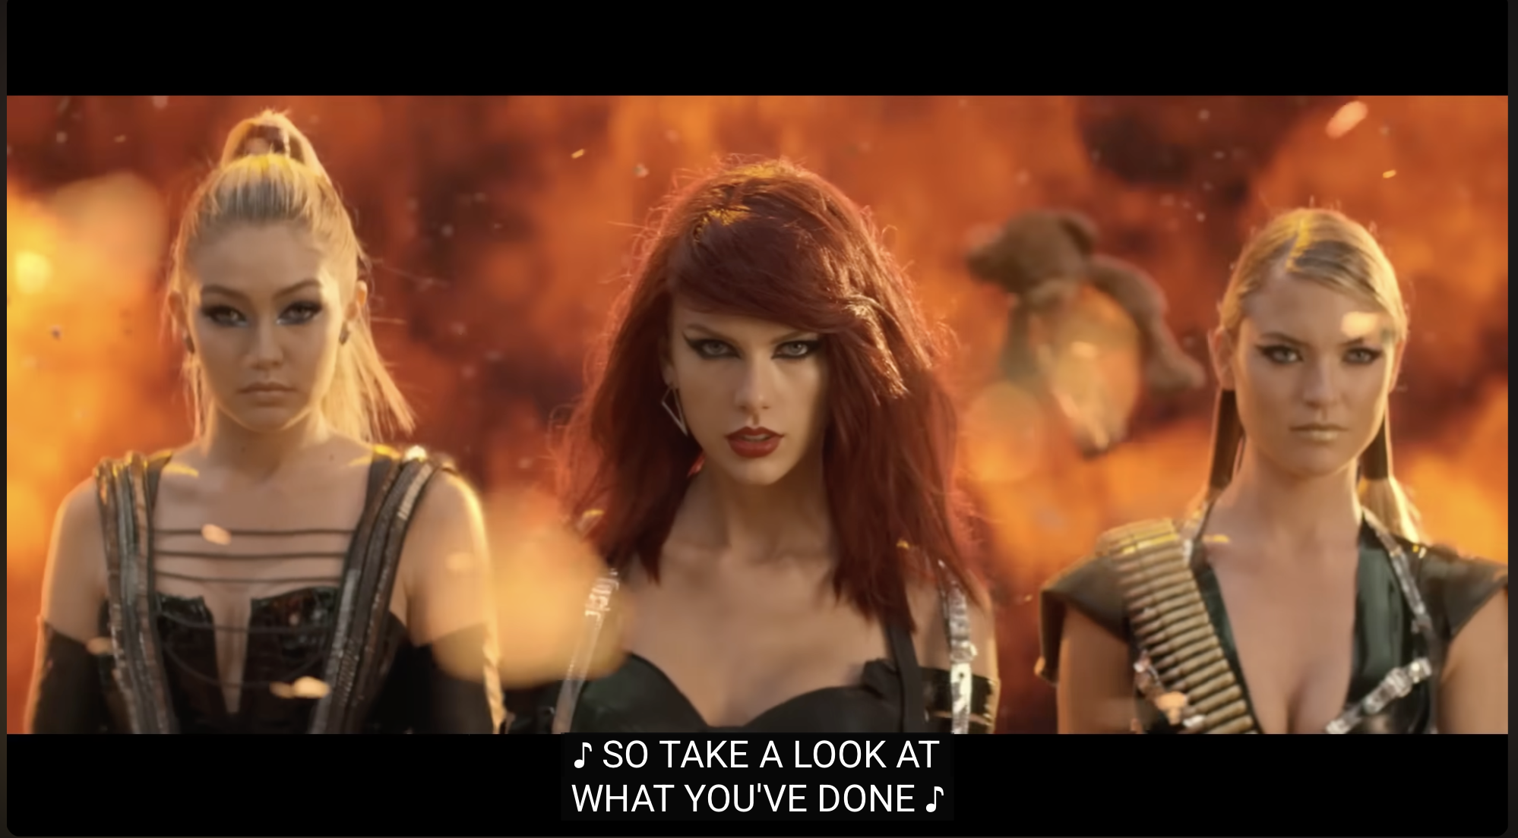
Notes:
Bad Blood

Slide 46
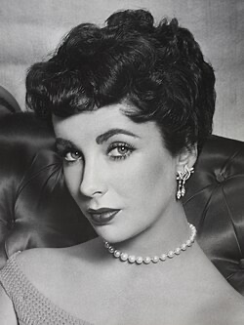
Notes:
Elizabeth Taylor

Slide 47
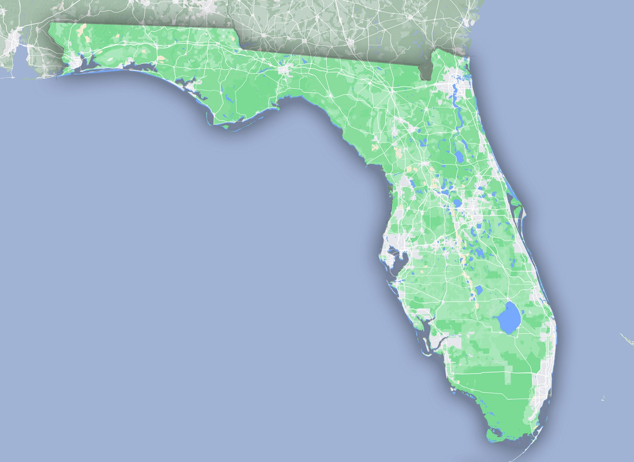
Notes:
Florida

Slide 48
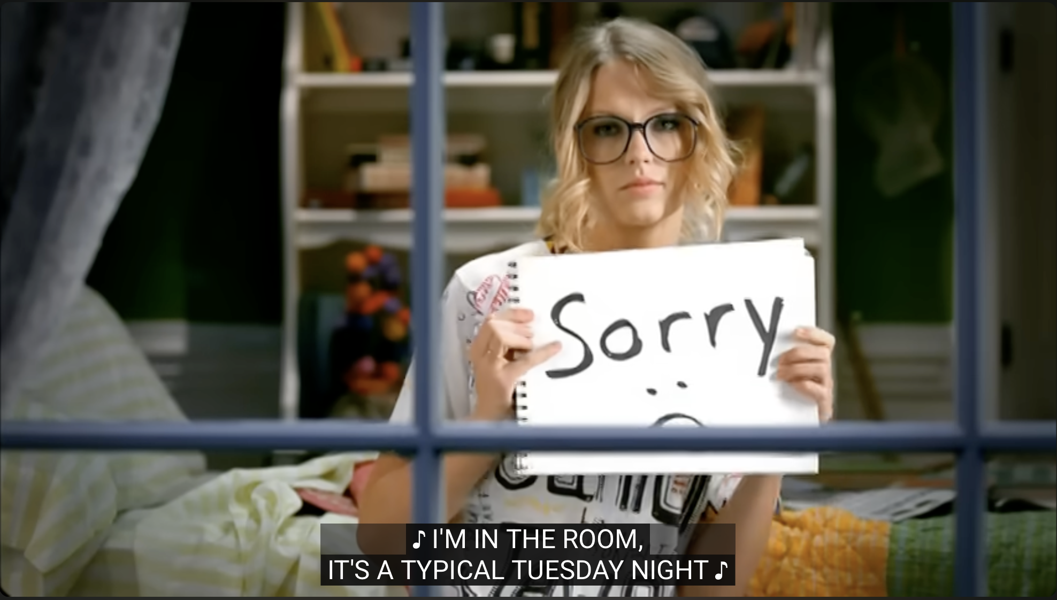
Notes:
You Belong With Me

Slide 49
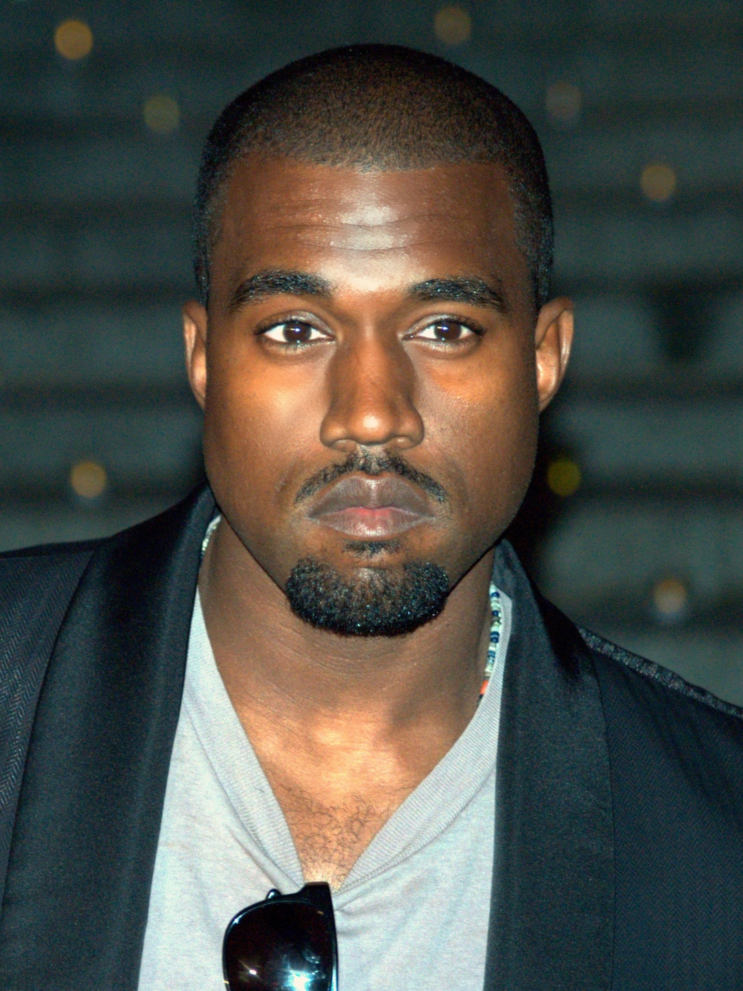
Notes:
Kanye West

Slide 50
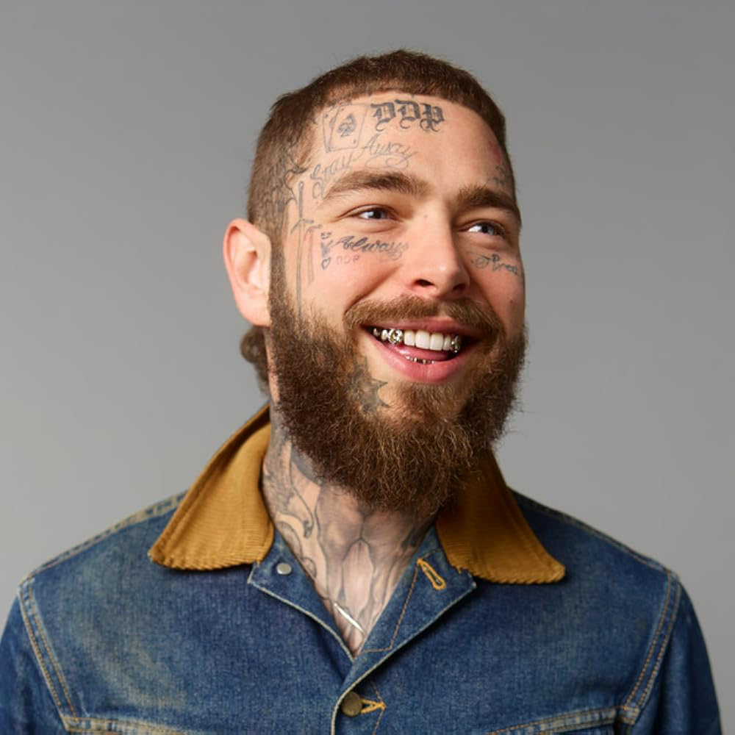
Notes:
Post Malone

Slide 51
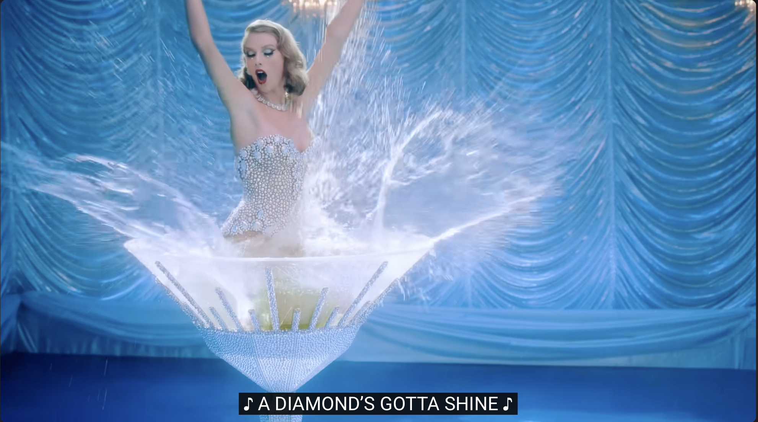
Notes:
Bejeweled

